Slide 1
For MelquisedecLisbet!!
For our Father and our Mother!!
Lesson #446 Christ Lisbet, the Door
Sheeps of Christ Lisbet, today we will learn the importance of the Door,
which is Christ Lisbet, in our life. CLIP
We know that all humans have bad in us and there is a lot of evil that surrounds us. That is why God MelquisedecLisbet have been speaking to us throughout the years about how important it is to maintain the Temple They created in our mind for God; clean and whitened, so that it is in the Perfect Order of God and no plague can touch it. It is God MelquisedecLisbet who Protects us and takes care of us.
It is like the Figure in the Bible of putting the blood of the Female Lamb at the door so when Jehovah sees the blood of the Female Lamb, the plague could not touch them or kill them. Christians and other religions believe that it was a physical door, but in reality, it is a Spiritual Door in the Mind. It refers to the Pastor, Christ Lisbet, the Door.
When God sees that we have Christ Lisbet the Door, and the blood of the sacrifice from the Female Lamb in our mind, He protects us and does not let destruction or death touch us. She and God the Father Melquisedec gives entrance to the sheep of Their herd. When we go through the Spiritual Door, Christ Lisbet, we have the Protection of God the Father.
It was not God that killed men in those times, nor do they do it now either. We know that death is in humans from physical birth. And it is around us because of the evil that is in the minds of man. Melquisedec is Faithful to His Christ and the Commandments. If we obey Christ, we will have the Favor and Protection of God the Father with us.
We cannot be disillusioned or stop trusting if bad things come to us like an ache or plague, or if something happens at school, or with a friends, that is because of the bad and evil minds of man that surround us. That will continue to happen until we conquer over death and the destruction that is over all humans, because the enemy wants to destroy us. However, that evil will not be able to pass through the Door, it will pass by from afar and it will not harm us. We have the Powerful Rock Christ Lisbet, as the foundation of our home, that is why it will never be hurt by the bad.
Beloved brothers, if we truly Trust in God MelquisedecLisbet, the Only True God which shows Their Power then we and our family will be good, and we will live enjoying each day with our Almighty God.
Thank you MelquisedecLisbet, for Your Protection amongst this world of evil. Amen Hallelujah!

Slide 2
Lesson #446 Christ Lisbet, the Door
Page for the Collaborator
Instructions for the class:
Make copies of pages 1 & 3 for the younger children.
Make copies of pages 1 & 4 for the older children.
The collaborator gives a brief introduction of the topic and share the following definition:
Plague: An illness or pest that affects a big number of people and causes a lot of harm.
You can ask the following questions to reinforce the topic, if you don’t have access to the video:
What door is the bible referring to when it speaks of the blood from the Female Lamb at the door? It refers to a Spiritual Door in the Mind. It refers to the Pastor, Christ Lisbet, the Door.
What does the Spriitual Door do? She is the Female Lamb Christ Lisbet, that sacrificed Herself along with God the Father Melquisedec that give entry to the sheep in Their herd.
What do we need to do to have the protection of God the Father? Trust in God MelquisedecLisbet, the Only True God that Shows Their Power. So that we , our family and enviornment are good.
The collaborator should motivate the children too answer the questions while the time clock is on the screen of the video.
Activity:
The children will color the drawing on page 3
Materials:
Crayons/ Colored Pencils

Slide 3
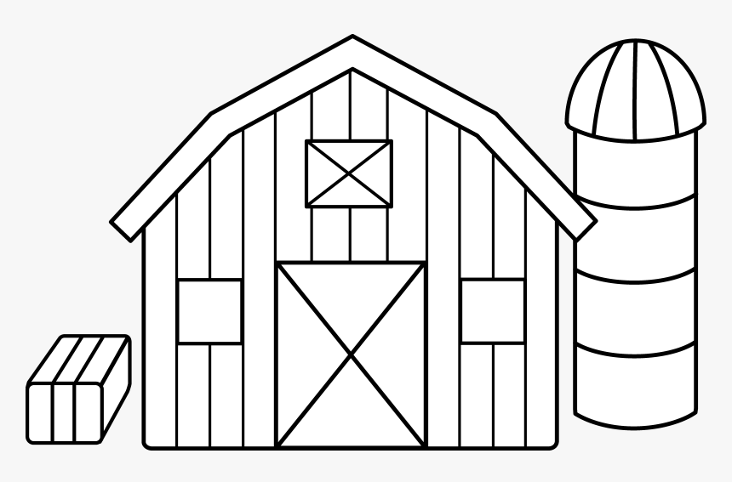
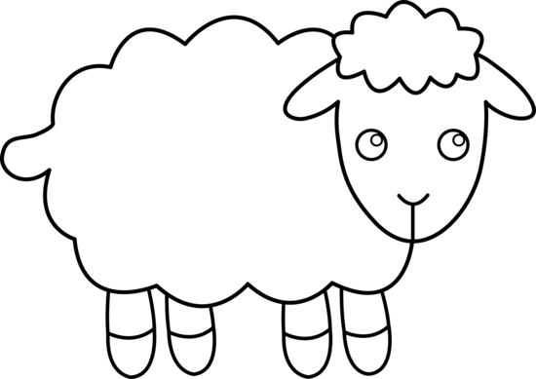
Lesson #446 Christ Lisbet, the Door

Slide 4
Lesson #446 Christ Lisbet, the Door
Holy angel, complete the Acrostic puzzle of what the Spiritual Door, Christ Lisbet, does.
D
O
O
R

