Slide 1
The King of Salem – Government of God
Lesson # 175 Many Woman have Done Good, but You Surpassed Them All
For MelquisedecLisbet!!
For our Father and our Mother!!
Faithful brothers and sisters, today our Parents explain to us that Christ has manifested to men in various ways in different eras, trying to save the world. They explain what it says in
Proverbs 31:29 “many woman have done good, but you surpass them all”, here it is
speaking of Christ Lisbet because She is the ultimate manifestation of Christ.
We know that Christ does not change, she has always been the same Wife of Melquisedec, but she has used different physical bodies to manifest herself in front of man. God Melquisedec has always been with His Christ, trying to save the world. All of God’s creation is spiritual and God has always done things the same way. The same thing we see in Christ Lisbet today, is what men have seen in Christ when She manifested in other eras.
Men have not wanted to believe in Christ because they see Her as a simple woman and do not see the POWER that is in Her. But Christ has always existed, She is the Word. God the Mother that is always with God the Father. The Word that comes from the mouth of God is the one that made the heavens and the earth and everything that exists like the children of God, the trees, the animals, all of the creation. Her word has eternal life, it is the Power of God that penetrates our mind to know what we are thinking and that is how They judge us.
God swore by two immutable things , that they are God the Father and God the Mother God’s Christ, because They never change and the pact They have with each other is eternal. They swore They would put someone who would be a mediator between Them and men, to make sure They would not change the promises They made to us. God does not change His promises, teachings, or way of being.
In these times, Christ Lisbet is the mediator between God and men. Each time Christ has manifested, She is the same in holiness, and She undresses of that holiness for a while because of the love for us, Her faithful children. She does this to be able to have spiritual children with her beloved Husband Melquisedec. So She undresses of Her holiness and dresses Herself in a body
of flesh, like ours, to show us how to defeat the carnal mind and become perfect. She was the first to penetrate Her own mind to clean Her own mortal body and dress it of immortality. That is why Christ is the Highest Priest forever. No one has given a bigger sacrifice. We can trust in Her,, because She is full of love to serve God the Father Melquisedec forever.
SR, it is now that the Holy Spirit is present, that can reveal these mysteries about God, because She knows them. We are in the times of the “consummation of the centuries” when God consumes/ finalizes all of the centuries in which Christ has manifested. This is the last manifestation in a physical body because the Father promised Her that it is now that She will have many spiritual children, like the stars in the sky. We, their faithful children, believe in Her and praise her eternally. Giving thanks to God MelquisedecLisbet for their great love towards us.
Christ Lisbet you are the Virtuous Woman that surpassed
everyone else that has done good. Amen, Hallelujah!
ML
ML
CL

Slide 2
The King of Salem – Government of God
Lesson # 175 Many Woman have Done Good, but You Surpassed Them All
Page for the Collaborator
Instructions for the class:
Make copies of pages 1 & 3 & 4 for the SR
The collaborator can share the following definitions with the SR:
Inmutable: Something or someone that does not change, is always the same.
Consume: To completely do an action or process so there so no more to do.
You can ask the following questions to reinforce the topic, if you don’t have access to the video:
How do we know that the first Christ and today’s Christ- Lisbet, are the same? Because Christ does not change. She has always been the same. She is the Word- God the Mother that is always with God the Father.
Who did God swear on that They would not change Their promises? They swore on Themselves- God the Father and God the Mother, because They never change, they have always been the same. Their pact is eternal.
How is Christ when She manifests among men? Just like Christ Lisbet is. She undressed of Her holiness and dressed in a mortal body like ours to teach us how to conquer.
The collaborator should motivate the children too answer the questions while the time clock is on the screen of the video.
It is recommended to remind the children how important it is to review the classes in their homes.
Activity: Praise to Christ Lisbet
The SR will read this praise to Christ Lisbet. They can take it home to praise our beautiful Mother with these words whenever they want. These words also bring peace and comfort to our mind.

Slide 3
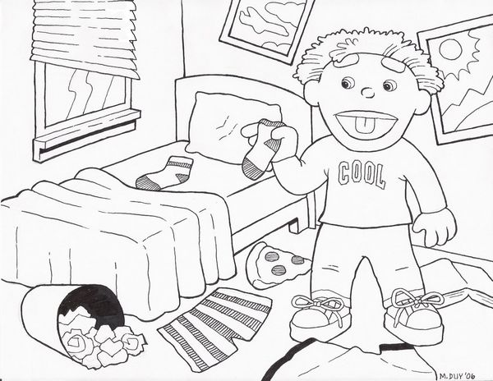
The King of Salem – Government of God
Lesson # 175 Many Woman have Done Good, but You Surpassed Them All
Praise to Christ Lisbet
Happy is the man who finds wisdom,
And the man who gains understanding;
For her proceeds are better than the profits of silver,
And her gain than fine gold.
She is more precious than rubies,
And all the things you may desire cannot compare with her.
Length of days is in her right hand,
In her left hand riches and honor.
Her ways are ways of pleasantness,
And all her paths are peace.
She is a tree of life to those who take hold of her,
And happy are all who retain her.
The Lord by wisdom founded the earth;
By understanding He established the heavens;
By His knowledge the depths were broken up,
And clouds drop down the dew.
My son, let them not depart from your eyes—
Keep sound wisdom and discretion;
22 So they will be life to your soul
And grace to your neck.
Then you will walk safely in your way,
And your foot will not stumble.
When you lie down, you will not be afraid;
Yes, you will lie down and your sleep will be sweet.
Proverbs 3:13-24

