Slide 1
Lesson # 299 The children praise MelquisedecLisbet
For MelquisedecLisbet!
For our Father and our Mother!
Faithful brothers and sisters, today we Will listen to some testimonies from the children of Christ Lisbet. Pay close attention because our Parents use these testimonies so that all their children can be edified. Clip 1
Edward: our brother gives thanks to MelquisedecLisbet for how well it went for him in fourth grade and how by treating the mean people in his class with the armor of Love, Patience, and Kindness of Christ Lisbet, one of those children became one of his best friends. He also thanks Them for having gotten excellent grades. He received 12 certificates for each Good thing he did throughout the year. He is grateful for having helped him take classes from home starting in sixth grade.
Aminah: Our sister shows us how she participates in the classes of the children of MelquisedecLisbet and does the activities. With this activity she was able to send her testimony of praise to MelquisedecLisbet for the love that They give us, for her family, for making her kind and making her a good student and helping her get better in Reading. She also thanks Them for their school, their Friends, her beautiful house and the protection of MelquisedecLisbet.
Clip 2
Zahí: Is grateful to MelquisedecLisbet because he is one of the outstanding students in his school. He is also grateful because his mom had to travel to another city for work reasons and he stayed with his grandparents, and even though they took good care of him, he missed his mom. He asked Melquisedec in the powerful name of Christ Lisbet for his mom to be able to come back to the city and they can live together again. Then his mom got transferred back to their city, all in the perfect time of MelquisedecLisbet. What beautiful Parents we have. They can do everything!
Our brother learned a lesson to not let his older brother govern him and to treat him with love instead. He was in a park and he was playing on something that his grandma had told him not to play on because it was dangerous, but he climbed on it anyway. Zahí fell from it and it was two feet off the ground, but he did not break any bones. He only hurt himself a Little, because his grandma had asked our Father Melquisedec in the name of our Mother Lisbet that he would not break any bones. He also shared that during this time being at home, he follows all the laws in peace and without fear.
Brothers and sisters, how beautiful that we can all grow spiritually, learning from each other and each time learning more to govern over our older brother and do what our spiritual Parents want from us. They love us so much.
How great it is to see the examples of how the children of MelquisedecLisbet listen to the teachings of Christ Lisbet in their homes with their parents and are obedient in everything. MelquisedecLisbet get very happy every time They see their children walking in Their Perfect Order, doing everything that pleases Them. It is beautiful to be able to praise the True and Sovereign God MelquisedecLisbet
Thank you MelquisedecLisbet for educating us and taking care of us with so much love. Amen Hallelujah!

Slide 2
Lesson # 299 The children praise MelquisedecLisbet
Page for the parent/ collaborator
Instructions for the class:
Make copies of pages 1 and 3 for the younger children
Make copies of pages 1 and 4 for the older children
The collaborator gives a brief introduction to the lesson
Activity: Sweet Maze
The children Will go through the maze with the help of our Wonderful Mother Christ Lisbet. They can also color the ice cream.
Activity: Older Children
The children will write 5 ways that MelquisedecLisbet have cared for them.
Materials:
Colored pencils/ crayons
Pencils

Slide 3
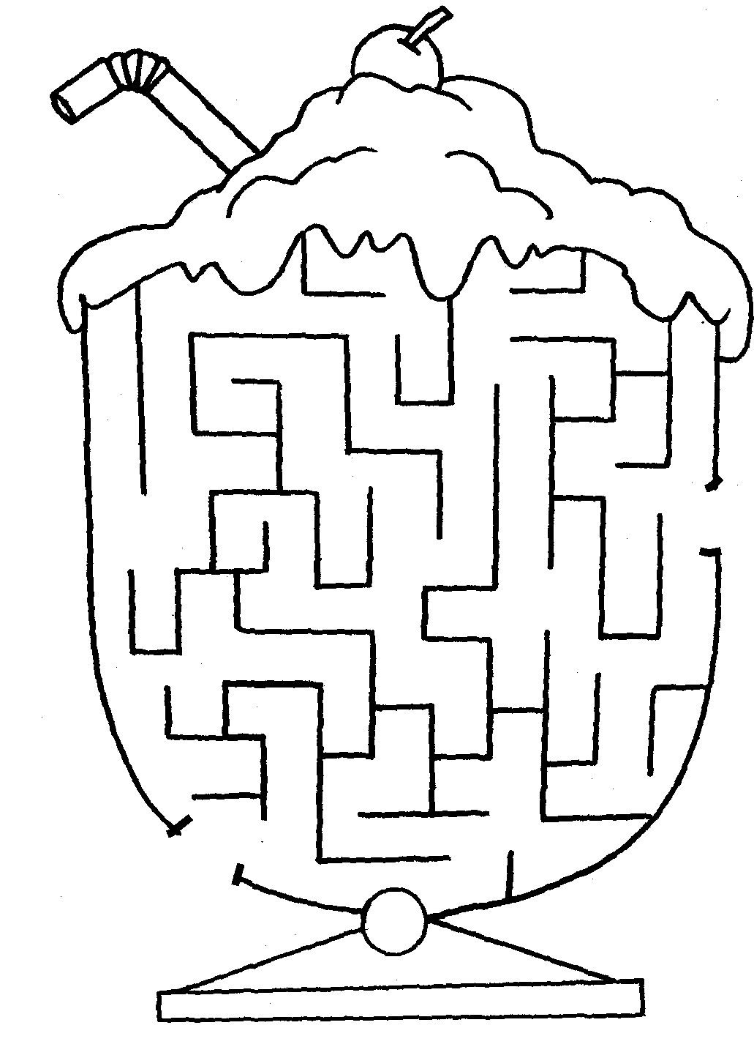
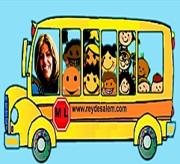
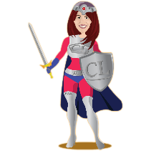
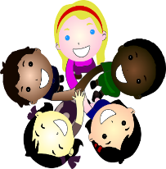
Lesson # 299 The children praise MelquisedecLisbet
We achieved it with the help of Christ Lisbet

Slide 4
Lesson # 299 The children praise MelquisedecLisbet
Thank you Parents MelquisedecLisbet for all the ways you care for me:
__________________________________
_____________________________________
2. ___________________________________
_____________________________________
3. ___________________________________
_____________________________________
4. ___________________________________
_____________________________________
5. ___________________________________
_____________________________________

