Slide 1
Lesson #373 The Stars Born of Christ Lisbet’s Spiritual Womb
For MelquisedecLisbet!!
For our Father and our Mother!!
Holy angels, today we will see how the creation of the shinning stars that are born from the Spiritual Holy Womb of Christ Lisbet, represent Spiritual Figures of the promises God the Father made to His Beloved Wife Lisbet.
John 3:8, the words of Christ are like the Wind that blows through the Mind of all that listen to Christ Lisbet, but it is not known who receives it to be born again, it is until the Good Fruit is seen and made visible that we know that person has been made a Legitimate Child of God.
Our Mother has told us that “everything comes to light.” The stars Born from Her Holy Spiritual Womb are making the Precious Light of Holiness from our Parents, shine brighter. We also see clearly the unjust actions of those that reject the light of God, that is why we see so much destruction, suffering, and illness all around the world.
In Ecclesiasticus 44:21 it says that God the Father Melquisedec Promised His Beloved Wife, Christ Lisbet, that He would bless the Nations in Her descendants The Figure of millions of stars are the Children born from the Spiritual Womb of Christ Lisbet that grow spiritually until we reach the fullness of the Stature of the Perfect Man. The hands of the Almighty God MelquisedecLisbet make the Holy Work of Their Perfect Creation, like it says in John 5:17.
We are the Holy Creation, the Spiritual Children formed from the bridal chamber of God.
Christ Lisbet is the Heavenly Womb in which God the Father engenders Spiritual Children,
that God gives birth to as Stars from The Holy Womb.
Each one of us needs to conquer over the carnal mind in ourselves, just like our Mother Lisbet did. She, as our Example, guides us with the Purifying Fire of Her Word and forms in our mind a Solid Foundation. Firm and immovable so that our new heavens and new earth can be formed in our mind. The Sun is God the Father, the Moon is God the Mother and the millions of stars are figure of the minds of their faithful children. But this formation is little by little, like Christ Lisbet says.
Brothers, how beautiful it is to see the fulfillment of the promises of God in the stars
born from the womb of Christ Lisbet, those of us that follow Christ Lisbet faithfully and
have conquered over the enemy in our minds. It is only through the Lord, Christ Lisbet,
that we can reach Her Perfect Holiness.
Our duty as Faithful and Brave Soldiers is to Teach, Share, Give Testimony, and Proudly present our Spiritual Mother with gratitude for making us shine like Her Children in Her Light and Their Shinning Stars amongst the darkness, because this is how the people of God MelquisedecLisbet will multiply in a great way for all Eternity like it says in Tobit 13:11.
Christ Lisbet, we are your Faithful and Holy children that are happy to live in Your Perfect Order. Amen, Hallelujah!

Slide 2
Lesson #373 The Stars Born of Christ Lisbet’s Spiritual Womb
Page for the Parents/Collaborator
Instructions for the class:
Make copies of pages 1 and 3 for the younger children
Make copies of pages 1 and 4 for the older children.
The collaborator gives a brief introduction to the topic
You can ask the following questions to reinforce the topic:
What are the millions of stars a figure of? Figures of the minds of the faithful children born from the womb of Christ Lisbet.
What is our duty as faithful and brave soldiers of God? Teach, Share, give Testimony, and Proudly present our Spiritual Mother, Christ Lisbet to others.
How can we reach the Perfect Holiness of God? Only through the Lady Lord Christ Lisbet.
It is recommended for the children to review the lesson during the week
Activity: Bright Stars
The children will make a sky made of their family using the molds from page 3.
Cut out the drawing of the sun/moon MelquisedecLisbet and glue onto construction paper
Cut out a star for each family member that is a bright star of Christ Lisbet
Write one name of each star and glue it onto construction paper
Cut out the verse and glue it onto the paper
You can decorate the rest of your sky as you want.
Materials:
Crayons/colored pencils
Construction paper
Scissors
Glue

Slide 3
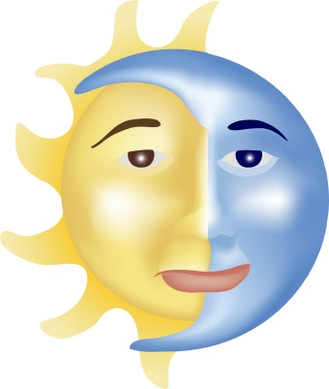
Lesson #373 The Stars Born of Christ Lisbet’s Spiritual Womb
Psalm 147:4-5
She counts the number of stars; She gives to all of them their names.
Great is our Lord, , MelquisedecLisbet, and abundant in power;
Her understanding is infinite.

Slide 4
Lesson #373 The Stars Born of Christ Lisbet’s Spiritual Womb
Holy angels, complete the crossword puzzle.

Slide 5
Lesson #373 The Stars Born of Christ Lisbet’s Spiritual Womb

