Slide 1
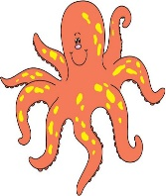
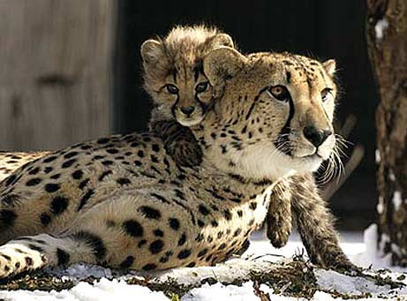
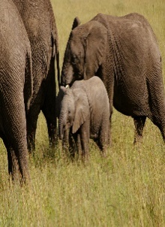
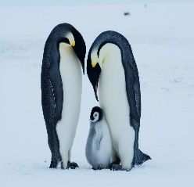
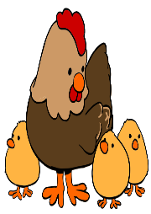
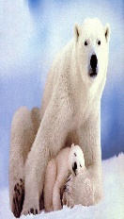
Lesson #291 The Love of God the Mother Reflected in Animals
For MelquisedecLisbet!
For our Father and our Mother!
Holy angels of Christ Lisbet, today we will see how the great love of God the
Mother is reflected in nature and in animals.
Our spiritual Mother Christ Lisbet has shown us her great love by coming to save us by giving us Her spiritual nourishment. She is the example of the love of the Mother and we see it reflected in animals too. Clip
We saw how the mother gives her all for her children:
Takes care of and protects her children
Finds and prepares food for her children
Feeds her children
She sacrifices herself for her children
Educates and disciplines her children
Has patience with her children
Loves her children while they are alive
Both the mother and the father care for and protect their children. We physically see God the Mother Christ Lisbet, but we know that it is both our Parents MelquisedecLisbet that do everything for us, because They are two in one. Just like our earthly parents, either it being your mom, your dad, or both; they take care of you and do everything for you.
Brothers and sisters, Christ Lisbet shows Her great Motherly love and is an example for us and for animals too, of how to take care of a child. That a mother sacrifices her own life to nourish and protect her children.
Christ Lisbet stripped away Her Holiness and took on a body just like ours to suffer just like us, to then show us how to conquer the carnal mind and save us from ourselves.
Isaiah 55:10-11 With Her wise words of eternal love, She nourishes us each week. She is patient and waits until we let Her clean us with Her Word that is Living and Effective. She takes care of us and helps us until we can conquer the carnal mind so we can be together with MelquisedecLisbet for eternity.
Thank you MelquisedecLisbet for Your
great LOVE for us. Amen, Hallelujah!

Slide 2
Lesson #291 The Love of God the Mother Reflected in Animals
Page for the Collaborators/ Parents
Instructions for the class:
Make copies of pages 1 and 3 in color for the younger children
Make copies of pages 1 and 4 for the older children
The collaborator can give a brief intro to the lesson and share the following definitions:
How are Christ Lisbet, our earthly parents, and animal parents alike?
Takes care of and protects us
Feeds us
Sacrifices herself for us
Educates and disciplines us
Has patience with us
Loves us
The collaborator should motivate the children too answer the questions while the time clock is on the screen of the video.
Activity: The love of a Mother
The children Will draw or write on page 3, how Christ Lisbey shows Her love as their Spiritual Mother. They can also add how their own parents show their love for them.
Materials:
Crayons/ colored pencils
Pencils

Slide 3
Lesson #291 The Love of God the Mother Reflected in Animals

Slide 4
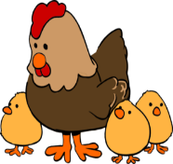
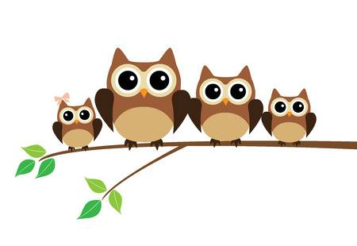
Lesson #291 The Love of God the Mother Reflected in Animals
Holy angels, draw a line from the circle to the phrases that represent the things Christ Lisbet, our earthly parents, and animal parents all have alike
Yell at us
Love us
Forget us
Discipline us
Take care of us
Scare us
Educate us
Feed us
Protect us
Don’t love us
Make us happy

