Slide 1
Lesson #322 Take Up Your Cross and Follow Me
For MelquisedecLisbet!!
For our Father and our Mother!!
Faithful brothers and sisters, today our Mother Lisbet explains what the cross really
is and how we should take it to be able to follow Christ.
We know that Christ did not have to die on a wooden cross to save man, like the world thinks. Christ’s sacrifice was leaving Her wisdom and holiness and dress in an earthly body just like ours. The death of Christ on the cross was dying to Her carnal mind. That is why She is the first in conquering over the carnal mind and serves as an example for us.
When Christ says, “take your cross and follow me,” it is very important and powerful, it is something spiritual. What our Mother is trying to tell us with that is that each one of us should:
Make an effort to obey and follow the commandments of Christ Lisbet
Leave behind the deceitful desires of the carnal mind
Leave behind the old way of living
Allow Christ to change our way of thinking and behavior, to think and act just like Christ Lisbet.
Christ told the paralytic “Stand up and take your walker and go.” The paralytic is a figure of someone that can not change by themselves, they cannot leave their disorderly life and change completely, without help from God. Only Christ Lisbet can make a human change their way of thinking and acting permanently/ forever. She does it through Her wise and powerful words, full of love and purity. So we can live a long, prosperous, and carefree life we must do everything that pleases God MelquisedecLisbet.
Beloved brothers and sisters, we have accepted the “Clean slate” and that means that we have taken our cross and are following Christ everyday. We offered a living and holy sacrifice by leaving behind the old man contaminated by evil and now live with a clean mind. Just like Christ, we died to our carnal mind and we like to live according to our new mind that Christ created in us. Now we are part of the body of Christ Lisbet and are faithful witnesses of the power that Christ Lisbet has in changing the lives of humans.
What a privilege we have that we have been given God’s most prized treasure, His Wisdom. How great that we now live in Christ Lisbet and our Works are righteous and Good like we have learned from Her so we can attain the great Reward, Eternal Life.
By following Christ we are not defeated by anything. We use the weapons that Christ Lisbet gives us to be able to conquer over any thought that comes to our mind that is not the truth that Christ teaches us. We are the example for the world of how to live in holiness, cleanliness, joy and peace.
MelquisedecLisbet, we want to be like YOU, that is why we like to
have a good behavior. Amen, Hallelujah!
ML

Slide 2
Lesson #322 Take Up Your Cross and Follow Me
Page for the Parent
Instructions for the lesson:
Make copies of pages 1 and 3 for the younger children
Make copies of pages 1 and 4 for the older children
You can give a brief introduction to the topic
You can ask the following questions to reinforce the topic, if you don’t have access to the video:
What does it mean to take your cross and follow Christ?
We should each:
Accept the ”clean slate”
Make an effort to obey and follow the commandments of Christ Lisbet
Leave behind the deceitful desires of the carnal mind
Leave behind the old way of living
Allow Christ to change our way of thinking and behavior, to think and act just like Christ Lisbet.
The parent should motivate the kids to answer the questions while the time clock is on the screen.
It is recommended to review the class during the week.
Activity: Book: I take up my cross and follow Christ Lisbet
The children will form a book about how they take their cross and follow Christ Lisbet. They will start it this week and finish it next week.
Cut out the pages for the book from page 3
Glue each page onto construction paper, to make the book firm
They can color the drawings
They can save the book to finish it next week
Materials:
Crayons/colored pencils Example:
Scissors
Glue
Construction paper
I take up my cross and follow Christ Lisbet

Slide 3
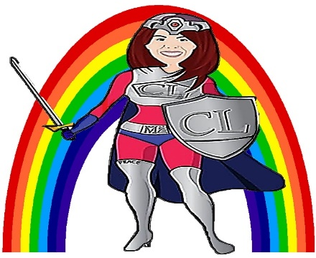
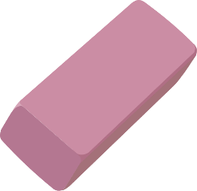
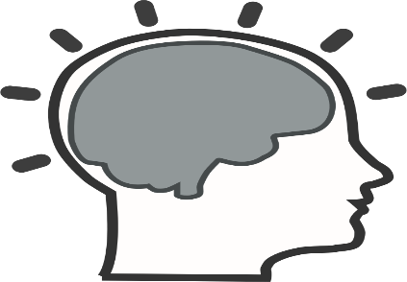
Lesson #322 Take Up Your Cross and Follow Me
I take my cross and follow Christ Lisbet
I accept the clean slate that Christ Lisbet gives me
Clean slate
I obey and follow the commandments of Christ Lisbet
I die to the deceitful desires of the carnal mind and old way of living
I honor my spiritual Mother & Father
I love my neighbor
Anger
Fear
Sadness
I let Christ change my way of thinking and behaving, to think and act just like Christ Lisbet
I use the weapons that Christ Lisbet gives me to conquer over any thought that comes to mind
Peace
Love
Obedience
Good and just works
Clean mind
Words of Christ Lisbet
Wisdom

