Slide 1
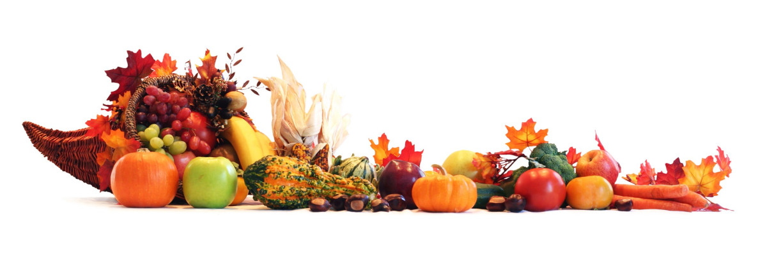
Lesson #314 The Fruitful Garden
For MelquisedecLisbet!
For the Father and the Mother!
Give
Thanks
Columns of the Temple of MelquisedecLisbet, today we will enjoy
a beautiful poem that talks about our Mother Lisbet. CLIP
Our sister tells us our Mother Lisbet takes us from glory to glory, in other words from Lisbet to Lisbet. With Her we go forward, and She is the Light that lights our path. If we walk in purity and holiness, we go securely towards eternity. The milk and honey that flows from the lips of Christ Lisbet are Her Words of eternal life.
It strengthens us to know our Father, that is so loving and detailed that gave everything to the Great I Am, our Mother Lisbet. We can know God the Father through God the Mother and He made everything because of and for His Wife. The care our Father has for our Mother Christ Lisbet is so noticeable that we can see it in Her, that is why She is our example to follow.
The phrase “Her river runs and refreshes us and Her trees give sweet fruit full of the seed necessary to extend and give to the neighbor,” are like the words of Christ that flow like a river of water that gives life and nourishes us, the trees, in a way that we have what we need to share this knowledge with others.
The phrase “You MelquisedecLisbet fill everything, in everything and for everyone,” means that MelquisedecLisbet are the only thing we need in our lives. They are everything for us.
What a privilege brothers and sisters, to be able to listen to the Great Lady Lord that is the Amen, the Faithful and True Witness , and the Beginning of the Creation of God. The one that gives us the example of a garden that gives good fruit.
Thank you Melquisedec for sharing Your Great Love, Christ Lisbet with us. Amen Hallelujah!

Slide 2
Lesson #314 The Fruitful Garden
Page for the parents
Instructions for the lesson:
Make copies of pages 1 and 3 for the younger children
Make copies of pages 1 and 5 for the older children
The parent gives a brief introduction to the topic
You can ask the following questions to reinforce the topic:
What do we need to securley get to eternity? Walk in purity and holiness.
2. What does it mean that MelquisedecLisbet fill everything, in everyone, and for everyone? That MelquisedecLisbet are the only thing we need in our lives. They are everything to us.
3. Who gives us the example of a garden that gives good fruit? Christ Lisbet
Activity: The Table of Nourishment
The children will make a table with their favorite food dishes. Just like our Mother Christ Lisbet nourishes us spiritually with Her Words, we need to nourish our bodies with food.
Cut out the plates from page 3
Either glue the plates onto the table on page 4, or glue the plates onto a piece of construction paper that will serve as the table.
The children can use items from around the house (ex: uncooked macaroni) to make their dishes or they can draw the food onto the plates.
The children can also decorate the table by drawing flowers, cups, utensils, ect.
Materials:
Pencil
Crayons
Scissor
Glue
Sheet of construction paper (optional)

Slide 3
Lesson #314 The Fruitful Garden

Slide 4
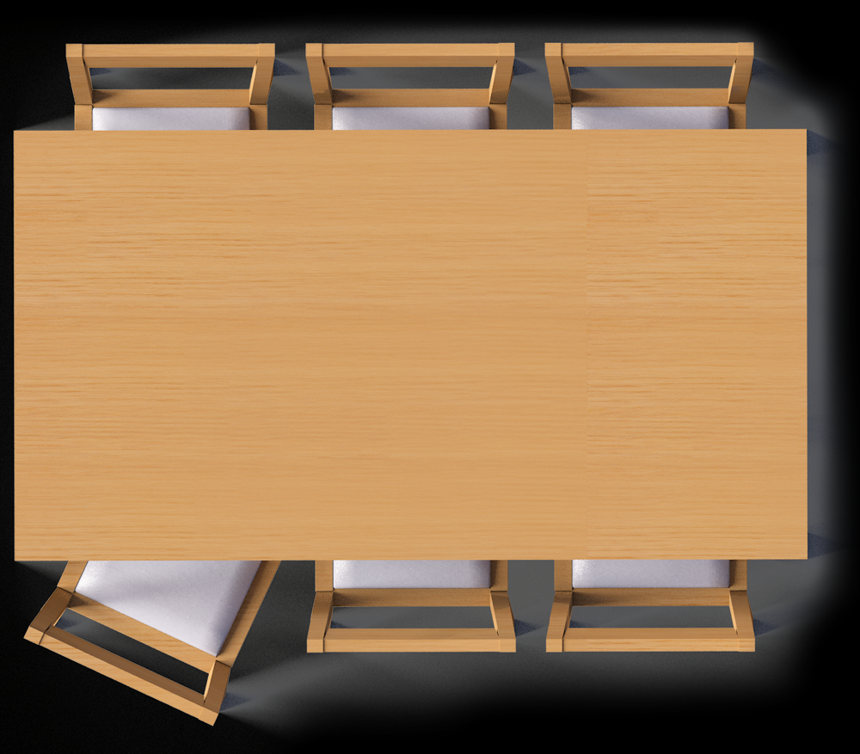

Slide 5
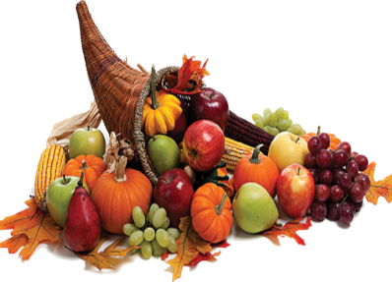
Lesson #314 The Fruitful Garden
Holy angels, complete the word search

