Slide 1
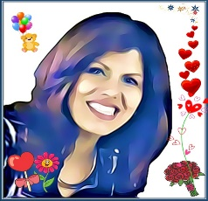
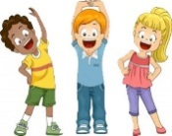
The King of Salem – Government of God
Lesson #176 The Resurrection
For MelquisedecLisbet!!
For our Father and our Mother!!
Brothers and sisters of light, today our Parents explain to us a little more about the
mystery of the resurrection of the dead. Christ was the first to die to a death of the cross,
which is to die to the carnal mind. Then She was resurrected by being born spiritually.
To be resurrected like Christ Lisbet was, we need to leave behind the old way of living according to the carnal mind and dress ourselves according to the new man created and taught by ML, in the justice and holiness of the truth. We can’t live or behave like everyone else if we are children of MelquisedecLisbet.
It is very important to receive and accept the “Clean Slate” that our Parents have given us, because it teaches us to live in Their Perfect Order- full of love, peace, truth and justice. Romans 6:13.
This means:
Our carnal mind will try to use every part of our body to make us fail God and avoid our resurrection. But CL has taught us to take all thoughts captive to the obedience of Her. That way we show satan who really reigns in our mind- CL.
All of our being should be consecrated to God: the spirit, the soul and the body.
We have a new life once we accept and receive the word of Life, to become immortal.
Our Parents give us a wonderful training of love where we learn to use the Power
of their knowledge and use every part of our body correctly to always give
glory to MelquisedecLisbet.
CL tells us that we are slaves to everything that dominates/controls us, but when we obey God then we become children and stop being slaves. We decide if we want to live or die. ML offer us a life of eternal Peace, Prosperity, Health, Well-being, and Joy. But there are many gods that take people to death and we should be careful so we can resurrect like CL.
Some are:
Bad moods - laziness - sadness - fear - fights – bad manners by not saying hi or bye or not saying please or thank you – being late – saying bad words – yelling – feeling better than or beneath others – being disorganized – speaking badly of others – answering by yelling – whining.
Beloved brothers and sisters, we need to give death to those things, leaving the old way of living behind and beginning and living in the Order of ML. Psalms 48:14 That is why our Parents guide us with so much love and mercy to immortality. Luke 20:36 They have promised to make us Their HOLY angels through their Word, CL, to give death to the outside gods and reach the resurrection of the spirit and have eternal life.
SR, we understand that the change that CL brings to our life is the best reward that we have ever received. That is why we work hard to obey their words of life and we do not use our mind, eyes, mouth, ears, hands, feet, or any part of us to do anything bad. Our mind and our body are holy. We are faithful children that are happy to live in the order of ML.
Christ Lisbet, with your Wisdom you take us through the path of immortality by teaching us the truth. That is why we praise MelquisedecLisbet forever. Amen, Hallelujah!

Slide 2
The King of Salem – Government of God
Lesson #176 The Resurrection
Page for the Collaborator
Instructions for the class:
Make copies of pages 1 & 3 for the younger SR
Make copies of pages 1 & 4 for the older SR
You can share the following definition with the SR:
Consecrated: Separated for God.
You can ask the following questions to reinforce the topic, if you don’t have access to the video:
What is the resurrection? To die to the carnal mind and live according to the spirit of God. Doing what is good, pure, and correct according to the Order of MelquisedecLisbet.
What should be consecrated for God? All our being, spirit, soul and body. That is why we do not use our mind, eyes, mouth, hands, feet, or anything to give bad.
What did MelquisedecLisbet promise us and how do they do it? To make us their HOLY angels and they do it through CL, the Word of God.
The collaborator should motivate the children too answer the questions while the time clock is on the screen of the video.
It is recommended to remind the children how important it is to review the classes in their homes.
Activity: I try to do what is good
The SR will color the drawing on page 3 that teaches us how to try to do the good and what is pleasing to ML to become resurrected like CL and achieve immortality.
Materials:
Crayons/colored pencils

Slide 3
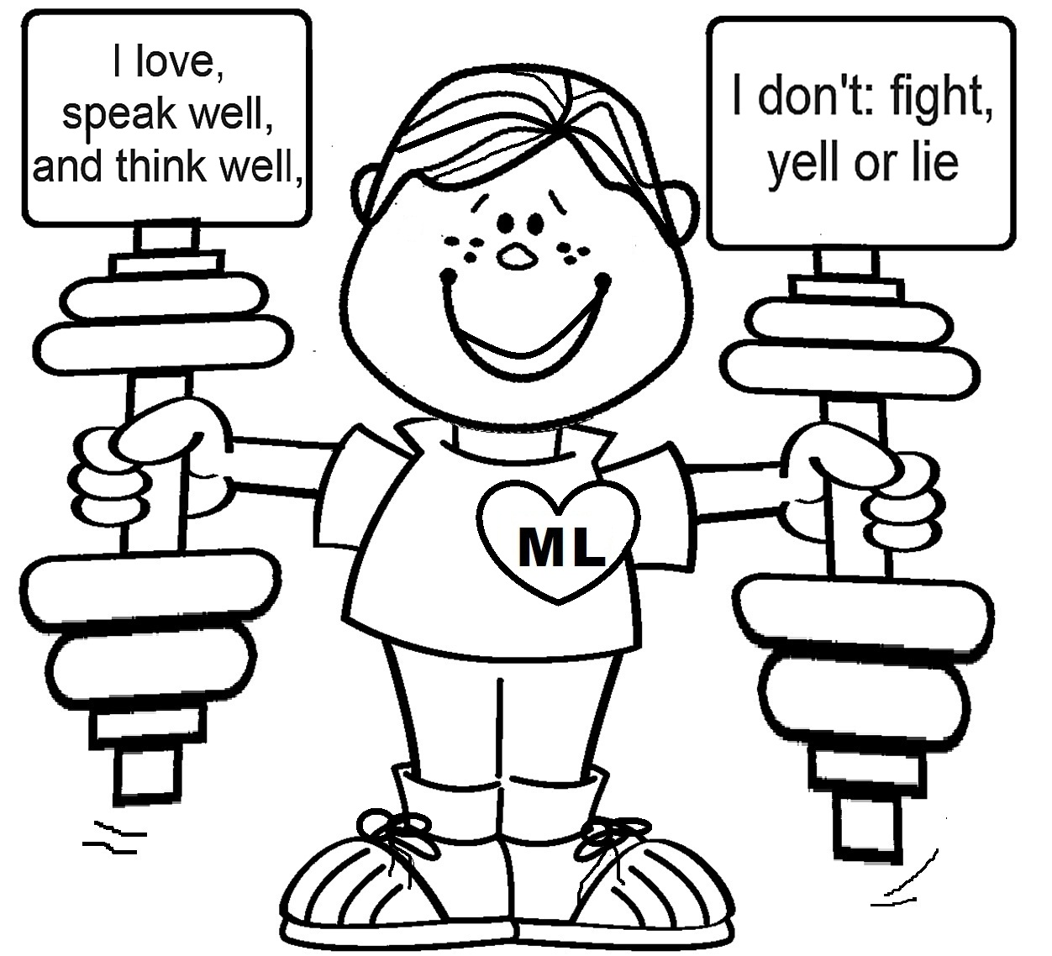
The King of Salem – Government of God
Lesson #176 The Resurrection
I train my mind and body with the powerful words of love of Christ Lisbet

Slide 4
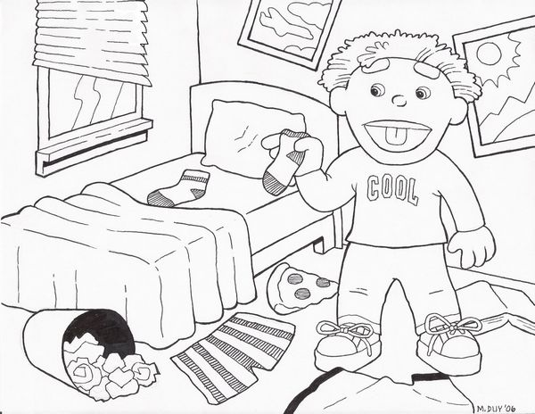
Do not let any part of your body become on instrument to do bad and serve sin.
Give yourself completely to God.
Because before they were dead, now they have life.
Our God is eternal and will always guide our lives!
We are going to build a die. Once you throw it it will land on one of the sides. Each child will say what they will do to reach this perfection. The teacher can make one big one to share amongst the class.
Cannot die either
They are like angels
And are children of God
Being children of the resurrection

