Slide 1
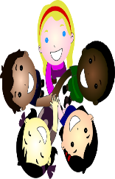
Lesson #275 MelquisedecLisbet’s Entourage
For MelquisedecLisbet!!
For our Father and our Mother!!
Faithful brothers and sisters, today Christ Lisbet explains that we
are the entourage of MelquisedecLisbet, in other words, Their holy
angels and first fruit. That is why They demands that we live a holy and
pure life.
The older brother does not like the word entourage, because it means that we are separated for MelquisedecLisbet. What this means is to not mix the precious words of Christ Lisbet with humanly customs that have nothing to do with the teachings that we learn in The King of Salem. Jeremiah 15:19
We are spiritual beings, chosen lineage, a holy nation, created in the Image and Likeness of the living God- MelquisedecLisbet. That is why we need to live in the following manner:
MelquisedecLisbet should be the most important and first in our life
Our friends should be friends of MelquisedecLisbet, we should know how to choose our friends
Act as MelquisedecLisbet ask of us, with love and doing everything correctly, not like others
Having a Good testimony in life, being desirable land for the foreigners, not having the same customs or doing what the rest of the world does
Obeying in everything
Share the knowledge that MelquisedecLisbet have given us
Holy angels, Christ Lisbet teaches us everything we need to not die, to be able to have eternal life. We have the privilege of being able to hear Her advice, to be able to read the bible and understand the figures, to have spiritual intelligence to retain Her teachings and put them into practice each day. Proverbs 7:1-5
I am your entourage MelquisedecLisbet. You are the most important to me and I choose to follow You. Amen, Hallelujah!

Slide 2
Lesson #275 MelquisedecLisbet’s Entourage
Page for the Collaborator
Instructions for the class:
Make copies of pages 1 and 3 for the younger children.
Make copies of pages 1 and 4 for the older children.
The collaborator gives a brief introduction to the topic and reminds the children of the meaning of the following words:
Entourage: A group of people that assist or surround an important person (followers). A person that is solely for the service to the King and the Queen, Their holy angels/first fruit.
Influence: The power someone has to change the way a person thinks or acts.
You can ask the following questions to reinforce the topic :
What does it mean to be seperated for MelquisedecLisbet? Not mixing the precious Words of Christ Lisbet with humanly customs that have nothing to do with the teachings that we learn in the King of Salem.
What does it mean to be MelquisedecLisbet’s entourage? To be their followers. Their holy angels/ first fruits.
It is recommended to remind the children of how important it is to review the lessons at home.
Activity:
The children will color the drawing on page 3.
Materials:
Crayons/colored pencils
Pencils

Slide 3
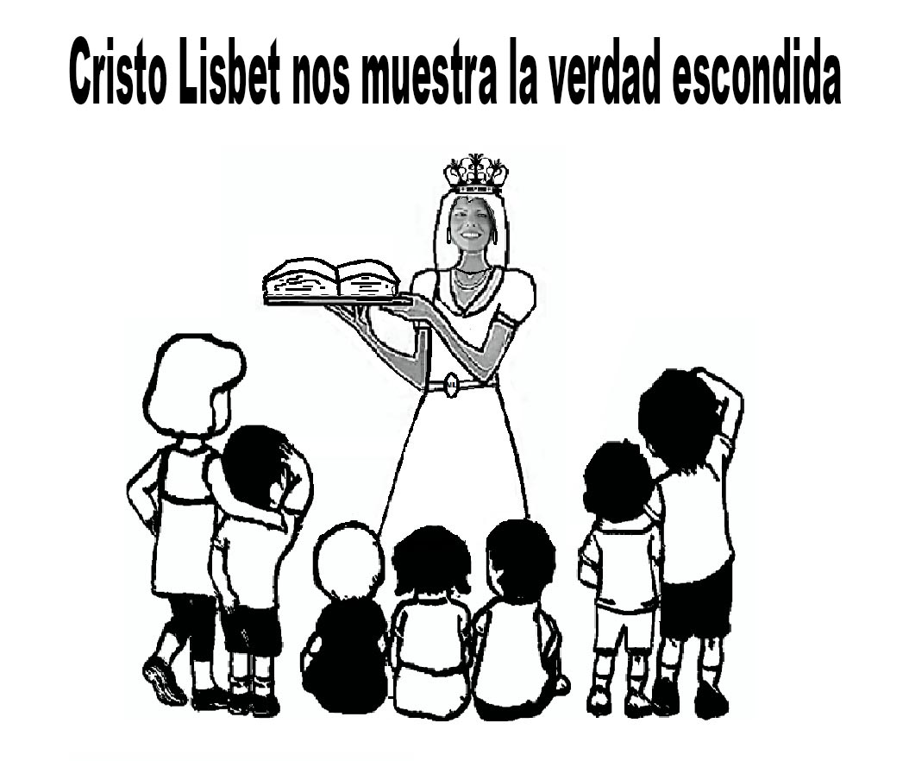
Lesson #275 MelquisedecLisbet’s Entourage
Christ Lisbet shows us the hidden truth

Slide 4
Lesson #275 MelquisedecLisbet’s Entourage
Complete the sentences with the knowledge you have received today from Christ Lisbet
We are spiritual beings, ______________ lineage.
We do to not mix the precious ____________ of Christ Lisbet with humanly customs.
Act as MelquisedecLisbet ask of us, with __________ and doing everything correctly, not like ______________.
We must have a Good testimony in __________, being desirable ___________ for the foreigners

