Slide 1
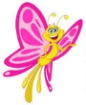
Lesson#332 Honor Your Father and
Your Mother
For MelquisedecLisbet!
For our Father and Mother!
Faithful brothers and sisters, today Christ Lisbet explains that “Honor your Father and your Mother” is the most important commandment that God has given us. She also explains the correct way to honor our Spiritual Father and Mother, MelquisedecLisbet. Christ is the first to fulfill all of God’s commandments and She teaches us how to do that.
From the beginning, our Mother has taught us that what is most important of the Wisdom
is the reverent fear towards God. Which is to love and respect them over all things. We
honor Them by doing everything They ask of us.
We should remain clean and pure, doing everything that is good and holy to God. With our thoughts well organized and having good behavior.
We should do everything that Christ Lisbet says because our Mother judges everything that is in our mind.
The verse Deuteronomy 5:16 cannot refer to our biological parents because they cannot give us eternal life. Our Mother also says that in some cases parents are not always good and treat their children bad, so it wouldn’t be fair for God to ask children to honor them.
This commandment is very important and we should not take it lightly. God has always asked the same of Their children in every era Christ has manifested in, trying to save man but man have not wanted to honor the Parents that have formed us in their image and likeness.
Only Christ Lisbet can explain to us how to honor God because She is the only one who truly knows Him. She was the first one to fulfill the law of God. She is who teaches us how God wants us to live and the correct way to behave. We can see and hear Her so we can be like Her. That is why we can honor MelquisedecLisbet.
Brothers and sisters, Christ Lisbet is our guide that comforts us and helps us keep our mind clean and living in the PERFECT and HOLY order of MelquisedecLisbet. God is always just and would not ask something of us that we cannot do.
We are docile to the voice of our Pastor and we obey in everything. We pay attention to the details to be able to be faithful in everything. What a great privilege we have to be able to see, hear, and obey the Almighty and merciful God that lives forever.
MelquisedecLisbet, thank you for the blessing of being able to fulfill the commandment of honoring my spiritual Father and Mother. Amen Hallelujah!

Slide 2
Lesson#332 Honor Your Father and
Your Mother
Page for the Parents
Instructions for the class:
Make copies of pages 1 and 3 in color for the younger children
Make copies of pages 1 and 4 for the older children
The collaborator can give a brief intro to the lesson and share the following definitions:
Honor: Showing and feeling great respect for someone.
Prolong: Make something longer
You can ask the following questions to reinforce the topic, if you don’t have access to the video:
Why does honoring the Father and Mother refer to MelquisedecLisbet and not our biological parents? Because only MelquisedecLisbet can give us eternal life like they promised. Our biological parents cannot.
How do I honor MelquisedecLisbet? By living in the Perfect and Holy Order that They teach us. By maintaining our mind clean and having good behavior, being faithful to God in everything.
The collaborator should motivate the children too answer the questions while the time clock is on the screen of the video.
It is recommended to remind the children how important it is to review the classes in their homes.
Activity: How I honor MelquisedecLisbet
The children will draw a line from the correct phrase towards the child to show how they honor our spiritual Father and Mother.
They can color the drawing.
Materials:
Pencils
Crayons/ colored pencils

Slide 3
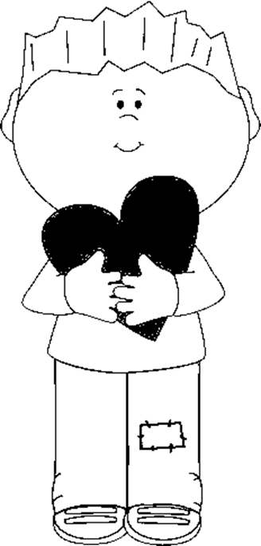
Lesson#332 Honor Your Father and
Your Mother
Holy Angel draw a line from the correct phrase towards the child to show how they honor our spiritual Father and Mother MelquisedecLisbet.
I obey Christ Lisbet
Sometimes I scream and fight
I get mad and cry about everything
I do everything with love
I am faithful to God
I have good behavior
I keep my mind clean and pure
I always listen to the wise words of Christ Lisbet

Slide 4
Lesson#332 Honor Your Father and
Your Mother
Holy angels, complete the word search

