Slide 1
Lesson #447 Accepting the invitation to the wedding
of the King and the Queen
Docile brothers, today Christ Lisbet tells us how important it is to accept the
invitation to the Weddings of the King and the Queen, God MelquisedecLisbet.
CLIP
If we believe with the Faith of Christ Lisbet, we are perfected by Christ Herself. The Perfection and most Sacred to God, is open to us and is giving us all of Her Truth. She, the Bridal-Chamber of God, invited us to enter the Wedding.
We have accepted that important invitation to enter the wedding of the King and the Queen and we have entered the Chamber of our Spiritual Parents, God MelquisedecLisbet. It is nice when the children of MelquisedecLisbet have the Confidence to enter our Spiritual Parents’ bedroom because we know that we will always find it Clean and transparent. That They always wait for us with open arms, ready to speak to us with the Truth, without lies or tricks, but instead with Cleanliness and Absolute Holiness so that we know what Their Perfect Will is.
When we enter the Chamber of God, we are seated at Their Holy Table, eating the food that comes from the Heaven of God, the mind of Christ Lisbet. She is the bread and wine of the Heaven of God. In the Wedding Suppers, God gives us the Holy and Eternal food which is all of the Wisdom of God the Father and Mother, that does not have beginning of days nor end of time that has always existed and will exist forever.
Brothers, how wonderful it is to know that these are not just words, but that we live according to the Will of God and have been able to prove the Promises of God fulfilled in our lives. We know we have the protection of God and that is why we are the most fortunate people in the world.
Thank you MelquisedecLisbet for Your invitation to the Wedding and for teaching us all Your Wisdom, so we can live according to the Will of God the Father. Amen Hallelujah!
For MelquisedecLisbet! For our Father and our Mother!

Slide 2
Lesson #447 Accepting the invitation to the wedding
of the King and the Queen
Page for the Collaborator/ Parent
Instructions for the class:
Make copies of pages 1 & 3 for the younger children.
Make copies of pages 1 & 4 for the older children.
The collaborator gives a brief introduction of the topic
You can ask the following questions to reinforce the topic, if you don’t have access to the video:
What does it mean to accept the invitation to the wedding of the King and the Queen? To have the Confidence to enter the Chambers, the bedroom of our Spiritual Parents, God MelquisedecLisbet; because we know that we Will always find it Clean and Transparent.
What happens when we enter the Chambers of God? We are sitting in Their Holy Table, eating the food that comes from the Heaven of God, the mind of Christ Lisbet. God gives us the Holt and Eternal Food, which is all of the Wisdom from God the Father and Mother, that does not have beginning of days nor end of days, that has always existed and will always exist.
The collaborator should motivate the children too answer the questions while the time clock is on the screen of the video.
Activity: Invitation to the wedding
The children will create a wedding invitation for the Weddings of MelquisedecLisbet, that they can give to a friend or family member they would like to enter the Chamber of Christ Lisbet and be taught by God the Father and the Mother.
Fold a piece of paper in three, like shown in the example
Cut out the phrase and picture from page 3 and glue it to the front of the invitation (A)
On the B side of the invitation, add the websites
On part C, you can write the invitee’s name and a short testi,ony of the promises of God fulfilled in your life
You can also decorate the invitation
Materials:
Scissors
Paper Example
Glue
Pencil
Crayons/ colored pencils (optional)
C
A
B

Slide 3
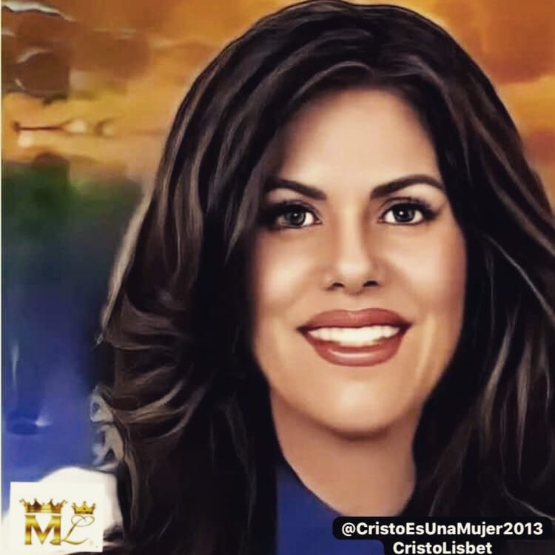
Lesson #447 Accepting the invitation to the wedding
of the King and the Queen
www.thekingofsalem.com
Christisawoman.com
Invitation to the Wedding of
MelquisedecLisbet

Slide 4
Lesson #447 Accepting the invitation to the wedding
of the King and the Queen
Holy angel, unscramble the words.

Slide 5
Lesson #447 Accepting the invitation to the wedding
of the King and the Queen

