Slide 1
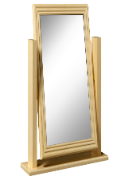
For MelquisedecLisbet!!
For our Father and our Mother!!
Lesson #276 The Law, Mirror of MelquisedecLisbet Part 2
ML
ML
Stars of the womb of Christ Lisbet, today we will learn how even in the fairy tales
we can see MelquisedecLisbet reflected in those characters and how we are also
like a mirror of MelquisedecLisbet.
We know that Christ Lisbet is our Law, She lets us see the True God the Father Melquisedec. It is only through Christ that God the Father allows Himself to be seen. We also know that Christ Lisbet is the Wisdom of God personified. She is the Mirror of God the Father and Mother.
In the story of Snow White and the Seven Dwarfs, we see how they use the mirror as the giver of wisdom. The evil witch asks the mirror: “Who is the fairest of them all?” The mirror answers: “Snow White.”
The stories of Snow White and of Sleeping Beauty are similar to the manifestation of Christ Lisbet in both dispensations because both princesses fall into a deep sleep due to the lies and wickedness of an enemy that tried to hurt them. These princesses could only be woken up by a true loves kiss. Our Father Melquisedec is Christ Lisbet’s true love. That is why only He could awaken Christ, His Queen, which slept under the spell of the carnal mind (Her enemy).
The evil witch is a figure of the carnal mind, that has the dominion of death, until Christ Lisbet was awoken. Later, then carnal mind finds out that only Christ is the Fairest and most Beautiful of all because She defeated death by being awoken by Her great Love, God the Father Melquisedec.
We, Their spiritual children are also like a mirror in both dispensation. In the past dispensation, our eyes were closed, but now in the new dispensation of the Spirit of God, we see Her Image and Likeness clearly. Christ Lisbet has given sight to the blind. She has let us see the Father and the Mother as They are. 2-Corinthians 3:18
In the past dispensation, we saw like a mirror in the darkness- we only knew parts, we knew Christ while She was asleep. But now, in the new dispensation of the Holy Spirit, we see God the Father and the Mother face-to-face clearly.
Brothers and sisters, we participated with Christ in the dispensation of darkness and death, and now we are still with Christ in the new dispensation of Her Light because we are Her holy creation. With Her words, MelquisedecLisbet clean our carnal mind and make us more like Them each day. Like a mirror, we can reflect Their Image and Likeness in our daily lives.
Thank you MelquisedecLisbet because now we can see you clearly face-to-face, just as You are. Amen Hallelujah!

Slide 2
Lesson #276 The Law, Mirror of MelquisedecLisbet Part 2
Page for the Collaborator
Instructions for the class:
Make copies of pages 1 & 3 for all the children.
The collaborator gives a brief introduction of the topic.
You can ask the following questions to reinforce the topic, if you don’t have access to the video :
How a fairy tales of Snow White and Sleeping Beauty similar to the manifestation of Christ Lisbet? Both princessess can only be awoken or revived with a true loves Kiss. Our Father Melquisedec is Christ Lisbet’s true love, that is why only He could awaken Christ, His Queen that slept under the spell of the carnal mind.
How are we also like a mirror of MelquisedecLisbet? Because we are Their holy Creation. With Their words, MelquisedecLisbet clean our carnal mind and make us more like Them each day. Like a mirror, we can reflect Their image and likeness in our daily lives.
The collaborator should motivate the children too answer the questions while the time clock is on the screen of the video.
It is recommended to remind the children how important it is to review the classes in their homes.
Activity:
The children Will color the drawing on page 3.
Materials:
Crayons/colored pencils

Slide 3
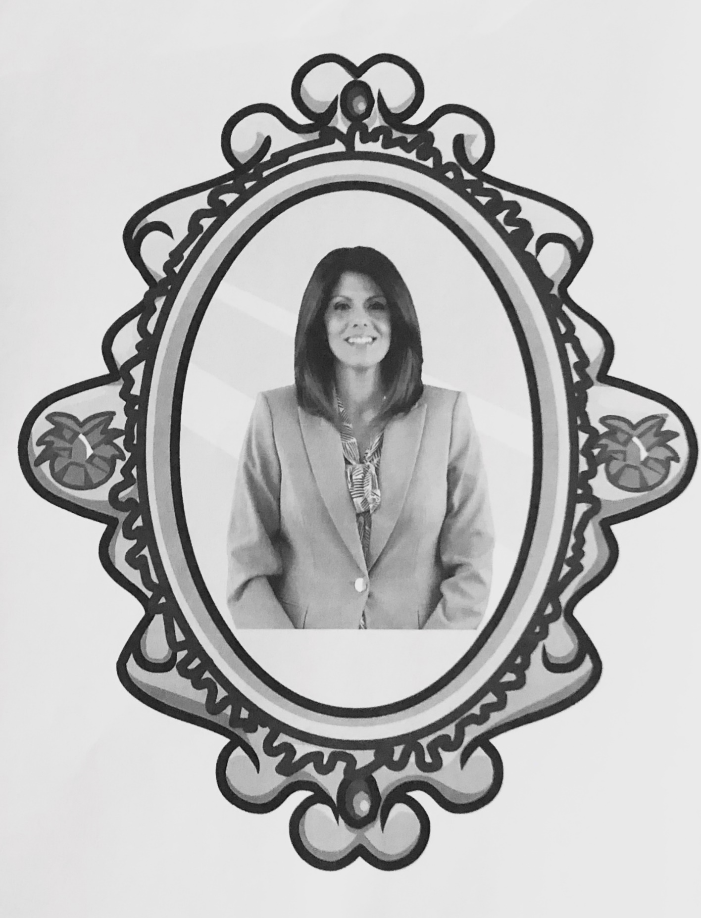
Lesson #276 The Law, Mirror of MelquisedecLisbet Part 2
With my mind, I reflect
MelquisedecLisbet

