Slide 1
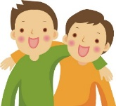
Lesson #375 The Chosen People of God
For MelquisedecLisbet!!
For our Father and our Mother!!
Holy angels, on January 3rd Christ Lisbet explained who the Chosen People of
God are and what that means. Christ acquired us by being present. Clip
Christ explained that it was God MelquisedecLisbet that chose us, it was not that we chose Them. They chose us in the previous dispensation to be the first-fruits of God in this second dispensation when Christ Lisbet is present. We are the people chosen by Christ from the world.
Christ Lisbet loves us like Melquisedec loves Her. We need to keep Her Commandments and remain in Her Love that is True and Powerful, just like Christ Lisbet has kept the Commandments of Her Beloved Husband, God the Father Melquisedec and has remained in His Love forever. Christ tells us this so Her Joy will be in us.
Her Commandment has always been for us to love one another, and this refers to loving our older brother and reconciling with him with love in the mind. We need to be Prudent, which is to be grateful for having been called by God and to do what God asks of us.
Christ Lisbet tells us that She is our friend, because She gave Her life for us and we always do what She commands. Like it says in John 15:15 Christ has told us everything that She has heard from Her Beloved Husband, God the Father Melquisedec and is our Friend. Christ Lisbet does not hide anything from us. She speaks the Truth and explains everything that is written.
We all have friends, and it is those people with which we share everything that is important to us. We like to play with them, speak to them, travel with them, and share our toys and everything we have with them. We trust them and we know they wouldn’t do anything to hurt us. That is just the same with Christ Lisbet when She tells us She is our Friend. She only wants what is good for us and when She asks something of us it is for our own good and that is why we Obey Her.
She chose us so we can take much Fruit to God and so that Fruit Remains. Everything that we ask our Father for in the name Lisbet, He gives to us. That is why She commands that we love ourselves in our mind.
Thank you Christ Lisbet for Choosing us to be Your Chosen People. Amen, Hallelujah!

Slide 2
Lesson #375 The Chosen People of God
Page for the Collaborator/Parents
Instructions for the class:
Make copies of pages 1 and 3 for the younger children
Make copies of pages 1 and 4 for the older children.
The collaborator gives a brief introduction to the topic
You can ask the following questions to reinforce the topic:
Why were we chosen to be the Chosen People of God? Because when Christ Lisbet gave Her life for us in Her Second Coming, we obeyed everything that She commanded of us. Also, so we would take much fruit to God and so that Fruit Remained and everything we ask the Father in the name Lisbet, He gives us.
What does it mean to love one another? To reconcile, with Love, with our older brother in the mind.
Why does Christ say She is our Friend? Because She has told us every thing She has Heard from God the Father Melquisedec. She doesn’t hide anything from us. She speaks with Truth and explains everything that was written.
The collaborator should motivate the children to answer the questions while the timer is on the screen.
It is recommended for the children to review the lesson during the week.
Activity:
The children will color the drawing on page 3.
Materials:
Colored pencils/crayons

Slide 3
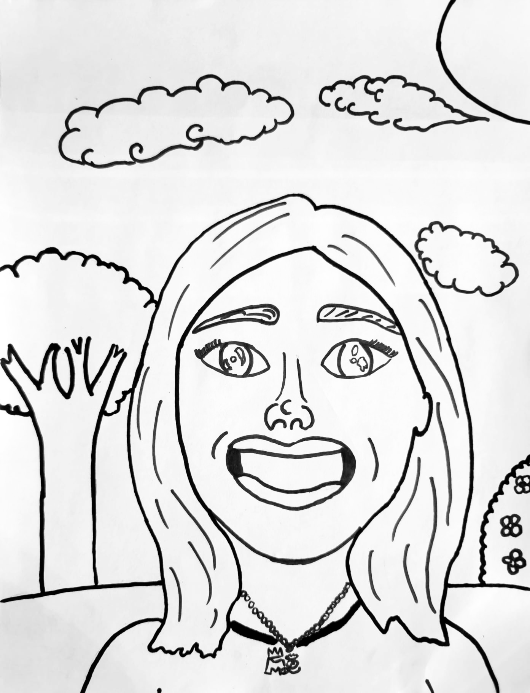
Lesson #375 The Chosen People of God

Slide 4
Lesson #375 The Chosen People of God

