Slide 1
Lesson 334 Testimonies of Christ Lisbet Part 2
For MelquisedecLisbet!
For our Father and our Mother!
Faithful brothers and sisters, today we will listen to more testimonies of our brothers and
sisters in the nations, about the power and care of Christ Lisbet and what she does in their lives
Clip David
David Amaya from Colombia: David shares how he had difficulties in school, and he was retained one year because he had difficulty Reading, understanding what he had read, bad handwriting, and trouble speaking. His mom sent him to live with his grandma. When he started living with his grandma, he started watching the mannas and starting watching the classes. David tells us that he likes the classes, and he likes doing the activities with his grandma. He thanks MelquisedecLisbet for letting him participate in the classes, because he has learned a lot.
He tells us that he prayed to our Parents Melquisedec with reverent fear in the name of Christ Lisbet to be able to speak without getting tongue twisted, to be able to read and understand what he is Reading, and to write well. A month later, our brother was writing very well. His teacher admired that his handwriting was so much better in so little time. He also sent a video of himself Reading and she was very pleased with it. He thanks our spiritual Parents for being able to improve in all subjects. He knows that if it wasn’t for MelquisedecLisbet, he would not have been able to do it so quickly.
David is thankful, because after his biological father abandoned him, he and his grandma prayed to Melquisedec in the name of our Mother Christ Lisbet that he and his three brothers would never need for anything, and that is how it has been. He is thankful because he now knows how to pray. That has brought him a lot of happiness because it has changed his life. He tells us his brothers also pray.
Clip Estefania
Estefanía Arias from Colombia: Estefanía tells us the wonder that MelquisedecLisbet have made in her mind. Our sister starts by thanking Them for her family, health, for the spiritual delicacies our Mother prepares, for her home, for the great love she has for her spiritual brothers and sisters, and for the Peace and Patience of Christ Lisbet, in all really everything. She thanks Christ Lisbet for all the advice and thoughts She puts in her mind. For being able to listen to Her Sweet and Wise voice, that always speaks to her and helps her make the right decisions.
Our sister was supposed to take virtual classes, but that never affected her, because she knew MelquisedecLisbet would help her, and that is what happened. She asked that They would help her get good grades and that it would go well for her in her classes, and she relaxed. When they handed out report cards, she saw that her petition was fulfilled because that is the Perfect Will of MelquisedecLisbet. Our sister received a tricolor medal, which means having an average higher that a 4.7 and she received even more. She was also on the honor roll, and they only pick three students per class and she was in first place. Estefanía was very happy because she knew it was thanks to Christ Lisbet.
Her biggest joy was seeing how the seed that Christ Lisbet planted in her was giving beautiful fruit that only the Only Wise and Powerful God, MelquisedecLisbet, can produce.
What beautiful testimonies from our brother and sister about how they know that everything good that happens in their lives is thanks to the Almighty God MelquisedecLisbet and they can trust in Them.
MelquisedecLisbet, thank you for teaching us to ask correctly and
then resting, because we can Trust in You. Amen Hallelujah!

Slide 2
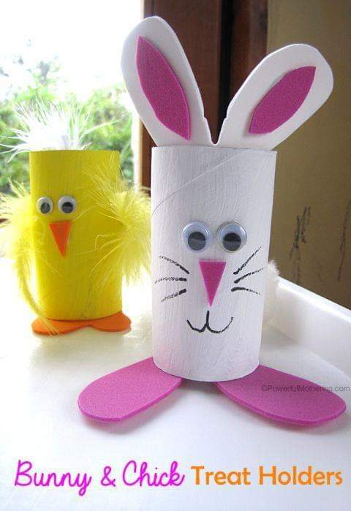
Lesson 334 Testimonies of Christ Lisbet Part 2
Page for the parent/ collaborator
Instructions for the class:
Make copies of pages 1, 3 and 4 for all the children
The collaborator can give a brief intro to the lesson
It is recommended to remind the children how important it is to review the classes in their homes.
Activity Sharing the wonders of MelquisedecLisbet
The children can play this game with their family or friends while at the same time, praising MelquisedecLisbet for so many wonders. The children will cut out the boxes from page 3, places the slips of paper into the chick or bunny and pick one out and do what the strips of paper say, then put it back in.
Bunny:
Cover the toilet paper roll with construction paper (see example).
Glue/tape the ears on the inside of the roll (use the molds on page 4 and trace onto construction paper)
Cut out and glue the feet on the bottom of the toilet paper roll (use the molds on page 4)
Glue on the googly eyes or draw some on
Cut out, trace, and glue the nose (mold on page 4)
Draw the whiskers and mouth
Chick:
Cover the toilet paper roll with construction paper (see example)
Cut out and glue the feet on the bottom of the toilet paper roll (use the molds on page 4 to trace onto construction paper)
Glue feathers on both sides of the chick, as the wings
Glue on the googly eyes or draw some on
Cut out, trace, and glue the beak (mold on page 4)
Materials:
Scissors
Toilet paper roll
Construction paper (yellow, pink, orange)
Googly eyes (optional)
Black marker
Feathers for the chick

Slide 3
Lesson 334 Testimonies of Christ Lisbet Part 2
Tell us something you have asked MelquisedecLisbet for and was given to you.
Tell us something you have learned in one of our classes.
Tell us how you pray each day and thank MelquisedecLisbet
Tell us something that has made you happy thanks to MelquisedecLisbet.
Tell us how MelquisedecLisbet help you do good in school/work/at home.

Slide 4
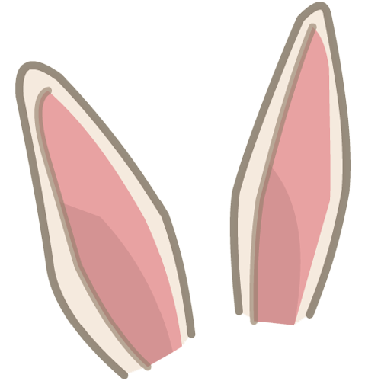
Lesson 334 Testimonies of Christ Lisbet Part 2
Bunny Paws
Chicken feet
Nose

