Slide 1
Lesson #357 In the Faith of Christ Lisbet
For MelquisedecLisbet!
For our Father and our Mother!
Firm Columns of the Temple of MelquisedecLisbet, today we will see how the Faith of Christ Lisbet, that lives through the Spirit of Her Word, guarantees us that we can Please the Holy God. Our Mother also reminds us how important it is to keep the Temple of God clean.
In Christ is the Fullness of God the Father and Mother, that is why in the Faith of Christ Lisbet:
The Justice of God MelquisedecLisbet is revealed
We are Justified and have Peace with God MelquisedecLisbet
We believe and that is why we Announce Her Good News
We are saved by Their Grace, because we accepted the Love of God
We are Resurrected along with Christ Lisbet
We fight the Good Spiritual Battle
With Her Patience we inherit Their Promises
We have Her Eternal Life because we do the Good Works that please God. That is how we show that we look for the Glory, Honor, and Immortality that ONLY God MelquisedecLisbet offer.
The Temple of God is not in every human being, ONLY in those that are Faithful and do EVERYTHING that our Lady God Christ Lisbet tells us to do. When we do everything our Mother Lisbet tells us, then we get God the Father Melquisedec to love us and They live with each of us in our mind, which is the Temple where God lives. CLIP
We are wise like MelquisedecLisbet, that is why we take care of our temple so that God never has to leave. They have put it in us to make us a Holy dwelling. They have made us Columns of Their temple and it is Christ Lisbet that holds us.
Brothers, today we are the witnesses that see the Majestic Works that MelquisedecLisbet do, by paying attention to the teachings that come directly from Them, the Omnipresent, All-knowing, All-powerful God. We are so privileged to see and listen to God. That is why we do not dare to contaminate the Temple where They have made Their Holy dwelling. We always keep it Clean and in Peace.
How beautiful to know that in the Faith of Christ Lisbet we can please God the Father Melquisedec. We are blessed to see and hear God showing us Their GREAT Power and Wonderful Love in our lives.
Thank you MelquisedecLisbet, for Your Faith and for teaching me to maintain Your Temple clean. I Love You and I do everything You tell me to so You can live there forever. Amen Hallelujah!
aith

Slide 2
Lesson #357 In the Faith of Christ Lisbet
Page for the Parents
Instructions for the class:
Make copies of pages 1 and 3 for the younger children
Make copies of pages 1 and 4 for the older children
The collaborator gives a brief introduction to the lesson
The collaborator asks the following questions to reinforce the lesson:
Name two ways you can please God in the Faith of Christ.
What should we do so that God MelquisedecLisbet can live in our mind, Their Temple? We should be Faithful and do EVERYTHING that Christ Lisbet tells us to do to maintain our mind Clean and in Peace.
Activity: With the Faith of Christ I Please Melquisedec
The children will connect the dots to form the picture. Then they can color the drawing.
Materials:
Pencil
Crayons/ colored pencils

Slide 3
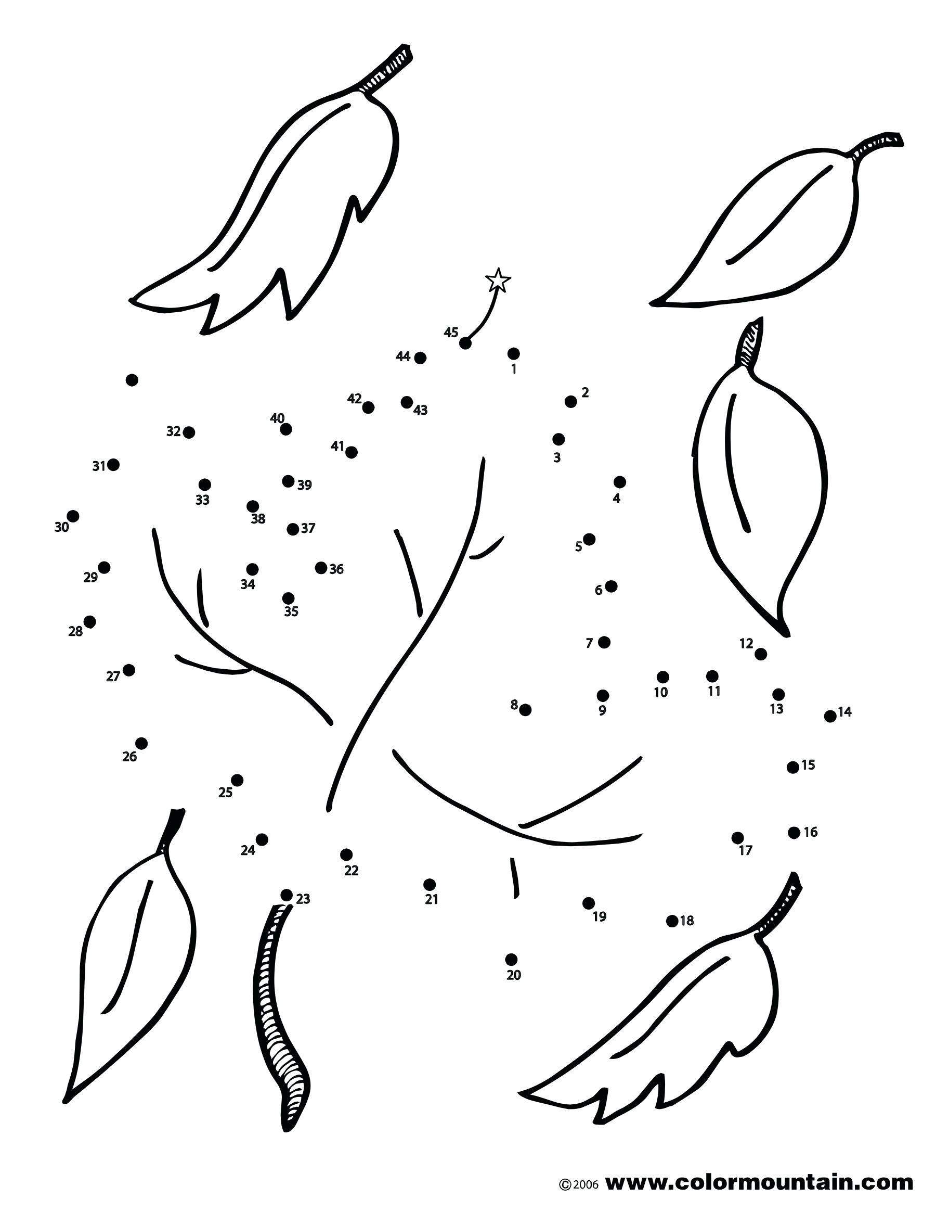
Lesson #357 In the Faith of Christ Lisbet

Slide 4
Lesson #357 In the Faith of Christ Lisbet

Slide 5
Lesson #357 In the Faith of Christ Lisbet
Answers

