Slide 1
Lesson #361 The Knowledge of
MelquisedecLisbet
For MelquisedecLisbet!!
For our Father and our Mother!!
Wise brothers and sisters, today our Mother Lisbet explains how MelquisedecLisbet always give us
the weapons we need to be victorious. The great Power of God MelquisedecLisbet is through Their Words and with the power there is in being made in Their image and likeness we can construct or destroy our life and the lives of those around us.
MelquisedecLisbet want us to be firm in the Knowledge that They share with us in each manna, writing, song of praise, poem, and everything else that is shown in the feast. Thanks to the Wisdom and Intelligence that They give us, we can apply this Knowledge to conquer over every obstacle that is presented to us in this Glorious eternity.
Wisdom means:
The capacity the nature of a human being has to know his existence and what surrounds him.
It is very important to know what Knowledge means and what it means to live in this beautiful Kingdom for eternity. It is said that humans have the capacity to know of their existence and what surrounds us thanks to its nature. Our nature is spiritual. That is why the Knowledge that MelquisedecLisbet give us is something very serious, necessary, and important to us because we live in a different Kingdom than mortal men.
Our Parents are always reminding us of the way we should live that pleases Them. That is why it is so important for us to review the mannas over and over again because the carnal nature tries to make us forget what we have learned. When we try to apply it to our lives, we forget it. That is when the Fire of the Living and Effective Word of Christ Lisbet comes so that we can live in Her Faithfulness, submission, patience, and love with our neighbor and those around us.
What MelquisedecLisbet want to achieve with this is that we be firm and remember that we are here for an eternity to live the Promises that our beloved Mother Christ Lisbet wants us to live and enjoy with Her and with our Father Melquisedec. If we have spiritual laziness and don’t review and apply this Knowledge that was given to us, we will not inherit Their promises.
We need to be clear that we are holy angels, made in the image and likeness of God MelquisedecLisbet,
and that Their only purpose is that we work with Them so that all those that are to arrive know with which purpose they have life and why they have been called by MelquisedecLisbet.
The Only and great purpose of our Parents MelquisedecLisbet is to establish Their Government in the mind of each human being. The Knowledge that They give us is to be applied Always, at all times and all places. Like it says in 2-Peter 1:8 and in Proverbs 2:1-5
Brothers and sisters, our Parents MelquisedecLisbet are always sharing Their Knowledge and reminding us that we should always apply it because that is where our glorious freedom is. The Word that we learn and retain should be accompanied by a testimony that can be seen, so that everyone knows that God MelquisedecLisbet are real and live and walk among us. The testimonies in our feasts are evidence MelquisedecLisbet are God of the living and not the dead.
Thank you MelquisedecLisbet for putting your Knowledge in my mind. I review it and apply it always, so that everyone can see Your power.
Amen, Hallelujah!
I am an open letter
I am an open letter

Slide 2
Lesson #361 The Knowledge of MelquisedecLisbet
Page for the Parent/Collaborator
Instructions for the class:
Make copies of pages 1, 3, 4 and 5 for all the children
The collaborator gives a brief introduction of the topic.
You can ask the following questions to reinforce the topic, if you don’t have access to the video:
How do we remember the knowledge MelquisedecLisbet give us and what does it do for us? By reviewing the manna over and over again, because the carnal nature tries to make us forget what we have learned. That is when the Fire of the Living and Effective Word of Christ Lisbet comes so that we can live in Her Faithfulness, submission, patience, and love with our neighbor and those around us.
What do MelquisedecLisbet want to do by us always remembering Their words? For us to be firm and remember that we are here for an eternity to Live the Promises and that we should apply it always, because that is where our glorious freedom is.
The parent should motivate the children too answer the questions while the time clock is on the screen of the video.
Activity: Game – The Knowledge of Christ Lisbet
The children will play the game “The Knowledge of Christ Lisbet”. This game shows how we conquer in our daily lives with Christ Lisbet in us.
Roll the die and move the indicated number of spaces.
Depending on the color/square you land on, you will do what the card of that color says (Pink, green, yellow, green, blue). You can ignore the arrows and the white spaces do not have a special meaning.
Materials:
A die
Button/ bean/ eraser, etc. as your game piece
An Additional Activity was added on page 5

Slide 3
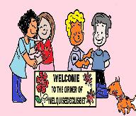
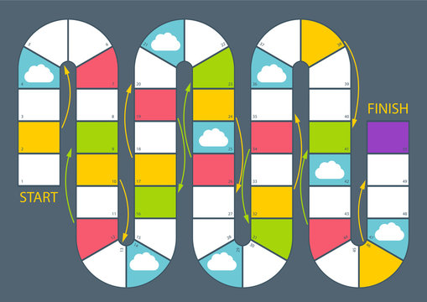
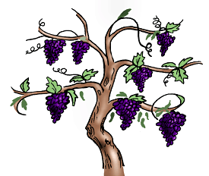
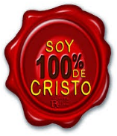
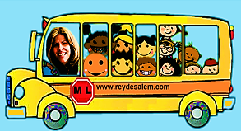
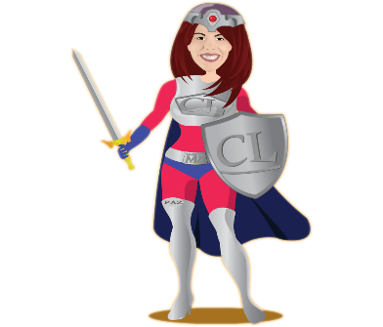
Go back
1 space
Go back
3 soaces
Go back
1 space
Regresa 1
espacio
Go back
2 spaces
Go back
2 spaces
Go back
3 spaces

Slide 4
Lesson #361 The Knowledge of MelquisedecLisbet
Sing a part of one of your favorite songs of praise for MelquisedecLisbet
Say something you learned in the lesson today
The children will play the Knowledge of Christ Lisbet board game. This game shows how we get through our daily lives with the knowledge Christ Lisbet has given us.
The children will need a die and can use any at-home item (a button, a block, an eraser, etc.) as their game piece. They will roll the die and move the number of spaces on the die. Based on the color square they land on (pink-green-yellow-blue); they will follow what the cards above say. Disregard the arrows.
9. You don’t understand a math problem
16. Someone is being mean to you
23. Your older brother tells you not to pick up your toys
31.You don’t want to do your homework
41.You don’t want to listen to a lesson again
Move up
2 spaces
According to the teachings of Christ Lisbet, what would you do with these obstacles:

Slide 5
Lesson #361 The Knowledge of MelquisedecLisbet
The children can form a skeleton like it shows in the example.
Materials:
Glue
Orange construction paper
Black marker
Cotton Swabs
Instructions:
Cut out the oval from this page to use as the head
Draw the eyes, nose and mouth
Glue the head onto the orange paper
Form the body using the cotton swabs

