Slide 1
Lesson #391 A Prudent Virgin
For MelquisedecLisbet!
For our Father and our Mother!
Faithful brothers and sisters, today Christ Lisbet explains what a prudent virgin
is and how they should behave. Let’s look at the meaning of a Prudent Virgin.
Prudent Virgin: Someone who has and behaves with Temperance or Moderation with their words and actions. CLIP
Christ tells us that a child that represents MelquisedecLisbet well is:
Someone that does not act hastily, but rather acts with temperance and moderation in their speech and actions.
Someone that dresses Christ Lisbet in fine linens.
Someone that speaks with love to help their neighbor because that is a good foundation.
Governs the mind with Justice and Righteousness
Always shows the Love of MelquisedecLisbet
Always finds how to fix all situations so there is peace
Christ reminds us how important it is for the foundation of our house to be firm so that it is always standing and never falls.
It is necessary to pick who to hate and who to love when it comes to Christ Lisbet and the carnal mind, but you cannot serve both. You must love one and hate the other.
Brothers, if we represent Christ well by being a prudent virgin, then we can live a life of prosperity and health. We do not allow thoughts that are not pleasing to God, so we do not get out of the Rest MelquisedecLisbet give us, and to not enter into a labyrinth of questions.
We allow ourselves to be helped by Christ Lisbet to be a new person born from the spirit. Your words give us peace, Mother. We live in Peace and Rest in the mind to reflect Your Peace in everything we do and so we can transmit that peace onto others.
Thank you MelquisedecLisbet because you teach me to be a prudent virgin. Amen, Hallelujah!

Slide 2
Lesson #391 A Prudent Virgin
Page for the Collaborator/Parent
Instructions for the class:
Make copies of pages 1 and 3 for all the younger children
Make copies of pages 1 and 4 for all the older children
The collaborator gives a brief introduction to the topic and review these words:
Temperance: Doing things with moderation.
Moderation: Being able to control our behavior.
You can ask the following questions to reinforce the topic
Why is it important for our house to have a strong foundation? So it is always standing and never falls.
Why should we choose who to serve between Christ and the carnal mind? Because you cannot serve both. We must love one and hate the other.
Why don’t we allow thoughts that are not pleasing to God enter our mind? So we do not get out of the Rest that MelquisedecLisbet give us and enter a labyrinth of questions.
It is recommended to remind the children of how important it is to review the lessons at home.
Activity: Connect the Dots
The children will connect the dots on page 3 to discover the drawing. Then they can color it.
Materials:
Pencil
Crayons/ colored pencils

Slide 3
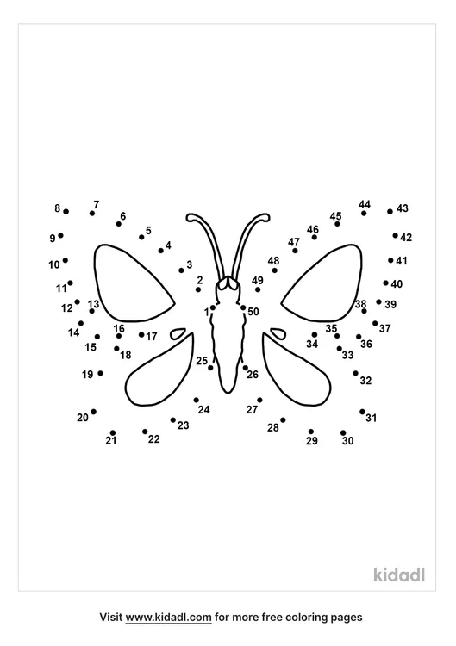
Lesson #391 A Prudent Virgin
Christ Lisbet transformed me into a new person and gives me PEACE!

Slide 4
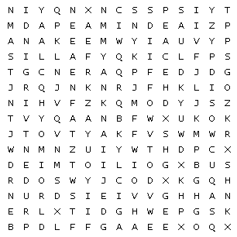
Lesson #391 A Prudent Virgin
Holy angels, complete the word search
Clean |  | Justice |  | Love
Mind |  | Peace |  | PrudentVirgin

