Slide 1
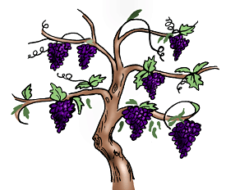
Lesson #444 How the world can be fixed
For MelquisedecLisbet!
For our Father and our Mother!
Faithful brothers, today Christ Lisbet tells us how to fix the world we live in.
She explains the very important role we have for this to happen and so we can all enjoy
this beautiful land. Clip
In the world, there are many disasters that occur like hurricanes, tornados, lightning storms, and strong winds, among other things. There is also a lot of evil like robberies, assassinations, traders, hate, fights, lies, jealousy, fears, and many other things that are not good.
The reason why it all happens is because of what is in the mind of human beings. Nature suffers because of the disorder, the fear, and filth in the mind of human beings that takes us to have all those bad behaviors and thoughts. That happens because they lack the Guidance from the True and Only God, Father and Mother MelquisedecLisbet.
Many human beings do not believe in God because they do not know Them. They do not know Their name, where They are and what is the behavior They demand. Others believe in a God which they have never seen, nor know, or know his name or what truly pleases him. They are all confused.
Only God and Christ can fix the men in Their Creation and Change their way of living, how it is Pleasing to God the Father. It is all through His Christ that it is achievable to be able to Live
Eternally in Their presence. It is necessary to be Attached to the True Vine Christ Lisbet.
That is why the manifestation of the True children of God is so necessary. Those of us that have been made in the Image and Likeness of God, which Christ has formed and created in our Mind, to be able to Help the world.
All of the creation is waiting, with great longing, the manifestation of the Children of God, of the True Worshippers of God, Their First-Fruits. That is why we are the only hope that the world has to be Healed and Perfected forever.
In the eternal Love of Christ and from Her Compassion for human beings, they all still have hope of being liberated from their own destruction. They have us, brothers and sisters. We are the example for the world to follow, of how to live a just, holy, and righteous life that is pleasing to God.
Brothers, we know how to Share this Glorious Freedom that we live in, we are the only Children of God born from the Spiritual Womb of the Heavenly JeruSalem, Christ Lisbet. Let’s be faithful witnesses and let’s take this Truth to the world so it can be fixed.
Thank you MelquisedecLisbet for Forming and Creating the spiritual man in our mind, to live how it is pleasing to You. Amen, Hallelujah!

Slide 2
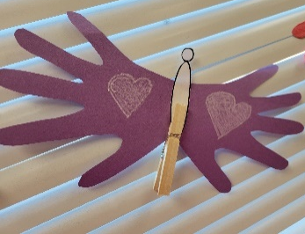
Lesson #444 How the world can be fixed
Page for the Parents/ Collaborator
Instructions for the class:
Make copies of pages 1 and 3 for the younger children.
Make copies of pages 1 and 4 for the older children.
The collaborator gives a brief introduction to the topic and shares the definition to this word: Anhelar: Cuando algo se desea con muchas ganas.
You can ask the following questions to reinforce the topic:
Why do the disasters in the world happen? because of the disorder, the fear, and filth in the mind of human beings that takes us to have all those bad behaviors and thoughts.
Who can fix the mind of human beings? Only God and Christ can Fix the man of Their Creation and change their way of life, to be pleasing to God the Father.
Who can fix the world with their example? The True children of God made in the Image and Likeness of God, the True Worshippers of God, Their First-Fruits. We are the only hope that the world has to be Healed and Perfected forever.
It is recommended to remind the children of the importance of reviewing the lessons during the week.
Activity: The children willl form a butterfly, like shown in the example.
Fold a piece of construction paper in half (hamburger style)
Trace one hand onto the paper with the wrist touching the folded edge
With the paper still folded, cut out the hand, starting on the folded edge
Cut out the butterfly body from page 3
Open the folded paper and glue the body onto the middle, see example
Decorate the butterfly
You can add a clothing clip to hang it somewhere
Materials:: Example:
Pencil
Crayons/ colored pencils
Construction paper
Scissors

Slide 3
Lesson #444 How the world can be fixed

Slide 4
Lesson #444 How the world can be fixed

Slide 5
Lesson #444 How the world can be fixed
Answers

