Slide 1
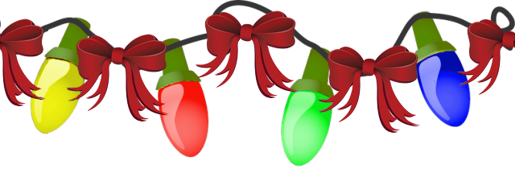
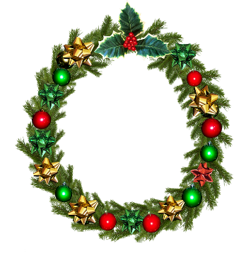
For MelquisedecLisbet!
For our Father and our Mother!
Lesson #370 Poem: Christ is a Woman
Bright stars, today we will listen to a beautiful poem that reminds us how Grand and Glorious Christ Lisbet is and of the benefits of Her Manifestation.
CLIP
Christ Lisbet is the Eternal Love of God the Father Melquisedec and She represents everything:
She manifested because of the Love She has for us
She is the Resurrection and the Only One that can give us Eternal Life
She is the Archangel that protects us- the Angel of the Covenant
She is the Mount of Zion, the Rose of Sharon, and Lily of the Valley
She is the Bread of Life, the Milk and Honey
She is the Olive Tree with much fruit
The Right Arm of God the Father Melquisedec
The Moon in All Her Splendor and Queen of the Heavens
She is the Rainbow, the Resplendent Morning Star and the Sun of Justice
She is the Queen of Salem, the Great High Priestess and Tabernacle of God
She is the Bridal Chamber where God the Father dwells
She is the Door, the Path, the Truth, and the Life
She Blesses us and gives us Mercy and took us from the Ignorance
She is our Liberator, Consoler, and Mediator
She is the Consecrated one, the Oath and the Promise
She is the Law of God Personified and the Rock of the Foundation
The Female Lamb and the Perfect Offering
The benefits we receive from Christ Lisbet are:
Her Spiritual Intelligence and Immortality
Abundance of Good and Perfection
Her Knowledge and Kindness
Her Patience and Transformation
Her Temperance and Holiness
Her Healing and Meekness
Her Joy
Her Eternal Life and Wisdom
Her order and faith
Brothers and sisters, MelquisedecLisbet are Two in One, the Plurality of God. Mother and Father, the Lord and Lady that love us. Only in Christ Lisbet can we see God the Father Melquisedec and from Her we receive all the Wisdom and Truth of God to be formed in Their Image and Likeness.
Christ Lisbet is the Love of God in Action. Our Spiritual Mother does everything our Father Melquisedec asks of Her. Our Queen is the perfect example to follow in order to please God the Father Melquisedec.
Thank you, Christ for loving us so much and sacrificing everything for us.
We Praise You, Almighty Goddess. Amen Hallelujah!

Slide 2
Lesson #370 Poem: Christ is a Woman
Page for the Collaborator/Parents
Instructions for the class:
Make copies of pages 1 and 3-9 for all the children
The collaborator/parent can give a short introduction to the lesson
It is recommended for the children to review the lesson during the week
Activity: Christmas Light
The children will form their name or someone in their family’s with the Christmas lights and they can use it as a decoration in their home or as a present.
Cut out the Lightbulbs to form a name
Color each light bulb, and you can use glitter too
Glue each lightbulb onto construction paper. See example.
They can make more than one
They can use the blank bulbs to write in their own letters for the name
If he/she wants they can staple or tape a string to the paper to hang it
Materials:
Crayons/colored pencils
Construction paper
Scissors
Glue Example:
Yarn or string (optional)
Glitter - optional

Slide 3
