Slide 1
Lesson #450 The Word of Eternal Holiness,
Christ Lisbet
Columns of the temple, how glorious to be a child of the God of the day,
the Light and Eternal Holiness. Today Christ Lisbet reminds us how important it is to know the name of God so we know who we should ask, to be answered by God. She tells us the importance of Listening Attentively, Scrutinizing and Obeying Their Holy Words.
Now that we know the Almighty name of God the Father and Christ, we can ask and have the certainty that God will give us what we have asked for with justice. By knowing the Eternal Word of Holiness of God MelquisedecLisbet, we know what it takes to have eternal life in the Justice and Peace of the heaven of God. We know that our mind should be Clean, Holy and Pure so our thinking, speech and actions are too. .
Christ tells us that only we, Their Holy Angels, are experiencing the Eternity of God. Because it is through Listening, Scrutinizing and Obeying the Eternal Wisdom, Christ Lisbet, in which Patience and Eternal Peace is seen and lived. It is in Christ Lisbet, the Word of God in action, where the commandments of God are. She communicates them by being present and shows, with Her actions, how we can fulfill them.
God only gives Their commandments being Present, Fulfilling them in Christ, in front of Faithful witnesses and the unfaithful. Those of us that enter the Kingdom of MelquisedecLisbet and remain there, are the Creation of the Spiritual world of God and loyal witnesses of what God does in our lives and we see how everything in our environment is corrected.
We, the Righteous and Prudent Children of Light have been able to prove that in the name of MelquisedecLisbet exists a power without equal that we had never known or experienced. We, the Spiritual Creation of God, have been made just like God MelquisedecLisbet, Faithful in EVERYTHING. We desire to Serve Them, Please Them and never fail Them.
MelquisedecLisbet, we Listen to You and Scrutinize carefully to do everything You ask of us, to please You always. Amen Hallelujah!
For MelquisedecLisbet! For our Father and our Mother!

Slide 2
Lesson #450 The Word of Eternal Holiness,
Christ Lisbet
Page for Parent/ Collaborator
Instructions for the class:
Make copies of pages 1 & 3 for the younger children.
Make copies of pages 1 & 4 for the older children.
The collaborator gives a brief introduction of the topic and share the following definition with the children:
Escudriñar: to examine something with a lot of attention, trying to find the details.
You can ask the following questions to reinforce the topic, if you don’t have access to the video:
How can you experience the Eternity of God? By listening, scrutinizing and obeying the eternal wisdom, Christ Lisbet, in Who is seen and lives the patience and eternal peace. It is in Christ Lisbet, the word of God in action where the commandments of God are. She communicates them by being present and shows us with Her actions how we should fulfill them.
How has God MelquisedecLisbet made their spiritual creation? the spiritual creation of God has been made just like God MelquisedecLisbet, Faithful in everything.
The collaborator should motivate the children too answer the questions while the time clock is on the screen of the video.
Activity:
The children will color the drawing on page 3.
Materials:
Crayons/ colored pencils
pencil

Slide 3
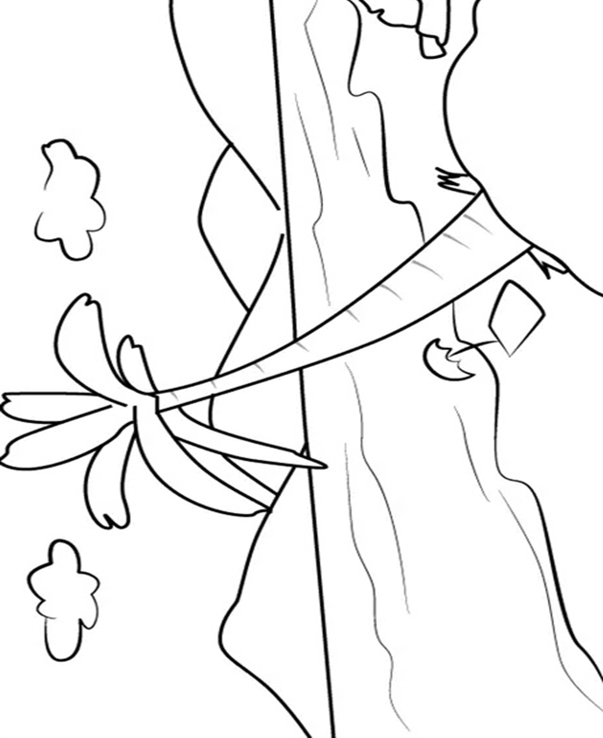
Lesson #450 The Word of Eternal Holiness,
Christ Lisbet

Slide 4
Lesson #450 The Word of Eternal Holiness,
Christ Lisbet
Notes:
0p-ooooooooooooooo

Slide 5
Lesson #450 The Word of Eternal Holiness,
Christ Lisbet

