Slide 1
Lesson #337 MelquisedecLisbet, the unknown God, that have Made Themselves known to the whole world
For MelquisedecLisbet!
For our Father and our Mother!
Faithful brothers and sisters, today we will learn about the figure of what it says in Acts 17:19-32 about an inscription that the Greeks have in a public plaza that reads “TO AN UNKNOWN GOD.” That figure was written to have fulfillment today in these times. The Time of the Manifestation of Christ Lisbet.
Many have not learned the name of the Only and Almighty God MelquisedecLisbet. They are “the unknown God” that now we, Their Holy Angels, are letting be known. We speak to others and tell them the name of God the Father Melquisedec and God the Mother Christ Lisbet, so they know it.
Maybe you have spoken to people and they say that they don’t know or believe that is the name of God. Do not worry, because if we think of the figure Elías, he thought that there was so much evil in this earth and was scared because he thought evil would be triumphant, but God said to him “and yet there are 7,000 who have not bowed the knee to baal.” This is a figure of men and women that have decided Not to let themselves be dominated by the carnal mind when they hear the voice of Christ Lisbet that shows them the way and what does not please God. And She shows them that the carnal mind is enemy of men and not a friend. This figure also teaches us that there are millions more that will come to MelquisedecLisbet once they learn the power that is in Their name and will be able to conquer in the carnal mind.
God the Mother has manifested in other eras, but those people made the mistake of believing that having God the Father and God the Mother was only for them. They became arrogant and would say “We have the True God” and thought less of other people. But we do not make that mistake because we know that the Love of God is bigger than all knowledge and Their Grace and Mercy does not have an end and it is good for everyone to know about MelquisedecLisbet.
Brothers and sisters, there are still many that address the UNKNOWN God, but soon they will know that Their name is MelquisedecLisbet and that They are amongst us. God uses us, Their Faithful Witnesses. That is why They ask us to live Holy lives because people are seeing our behavior in our homes, with our families, friends and co-workers or classmates. They are watching to see if our behavior is according to the holy words of Christ Lisbet. We should be sweet and cordial with others because it is through our actions that they will believe in MelquisedecLisbet.
Christ Lisbet is honest and is faithful and loyal to the words of God Melquisedec. We should be the same way: honest, faithful and loyal to what we learn from MelquisedecLisbet, to be Their image and likeness.
What joy to know that soon the earth will be like Christ Lisbet has said, that all violence, anxiety, tears, and hurt will be taken away and our Parents MelquisedecLisbet will be with us always.
MelquisedecLisbet, all the Just will know you and say “MelquisedecLisbet
Live forever.” Amen, Hallelujah!

Slide 2
Lesson #337 MelquisedecLisbet, the unknown God, that have Made Themselves known to the whole world
Page for the collaborator/ parents
Instructions for the class:
Make copies of pages 1 and 3 for the younger children
Make copies of page 1 and 4 for the older children
The collaborator can give a brief intro to the lesson
You can ask the following questions to reinforce the lesson:
Why do we say that the figure of the inscription “To an UNKNOWN GOD” is fulfilled today?
Many have not learned the name of the Only and Almighty God
MelquisedecLisbet and we are letting it be known today.
2.What does and yet there are 7,000 who have not bowed the knee to baal
mean?
This is a figure of men and women that have decided Not to let themselves be dominated by the carnal mind when they hear the voice of Christ Lisbet that shows them the way and what does not please God.
It is also figure of there being millions more that will come to MelquisedecLisbet.
It is recommended to remind the children how important it is to review the classes in their homes.
Activity: Announcing MelquisedecLisbet
The children will color the drawing on page 3.
Materials:
Crayons/ colored pencils

Slide 3
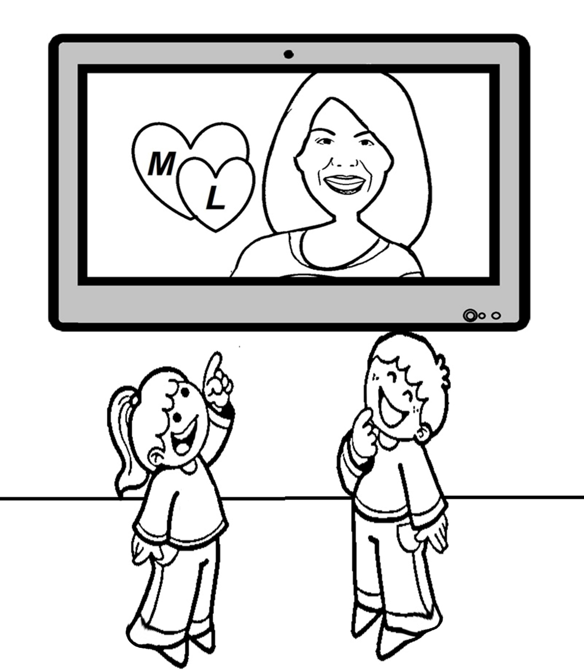
Lesson #337 MelquisedecLisbet, the unknown God, that have Made Themselves known to the whole world
I present to you: God

Slide 4
Lesson #337 MelquisedecLisbet, the unknown God, that have Made Themselves known to the whole world
Holy angel, complete the sentences.
1. Many have not learned the name of the _____________ and Almighty God MelquisedecLisbet.
2. MelquisedecLisbet are “the _________________ God” that now we, Their Holy Angels, are letting be known.
3. The figure of Elias teaches us that there are ______________ more that will come to MelquisedecLisbet.
4. There are still many that address the UNKNOWN God, but soon they will know that Their name is _________________________.
5. We should be honest, _____________________ and ____________________ to what we learn from MelquisedecLisbet.

