Slide 1
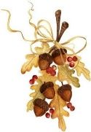
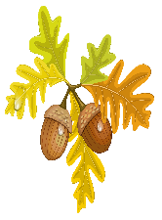
Lesson #309 The Resurrection and the Death P1
For MelquisedecLisbet!
For our Father and our Mother!
Brothers and sisters, today Christ Lisbet explains how the resurrection of Christ happens
first and then She dies. We will see what the resurrection is and what we should
do to be able to resurrect and die like Christ has done.
Christ Lisbet tells us that giving death to death, just like Christ did, means to conquer over everything that takes us to death, putting an end to that. To be able to achieve that, it takes time. We need the time of God and Their Wisdom to be able to conquer death.
It is necessary to be alive physically to reach resurrection and eternal life and that way conquer over sheol. The Sheol are dense or powerful thoughts that separate us from God. We cannot pay attention to them and Christ teaches us how to walk on the Waters and conquer over those thoughts. The purpose of the carnal mind is to keep you in those waters of bad thoughts to take you to physical death. Only Christ Lisbet can teach us to conquer over those thoughts that try to destroy us. Just like God the Father Melquisedec taught Her to conquer.
Only in the resurrection can we become perfect like God wants us to be. God expects perfection in Their Holiness and They know that we can achieve that. MelquisedecLisbet would not ask something of us that we could not achieve. That is why we have our Help mate our Spiritual Mother, Christ Lisbet. She helps us to be perfect in front of God.
The resurrection and the knowledge from the heavens are the same, because if it is because of lack of knowledge from God that the people perish, then by Them giving us the knowledge from the heavens, we are resurrected along with Christ Lisbet. It is the privilege of hearing the Word made flesh that resurrects us.
After Christ resurrects us with Her Wise words of Life, She asks us to take our cross and follow Her in Her spiritual growth. Christ is our guide and example to follow of how to conquer over physical death and reach the Father to Live Eternally.
You Resurrect through the Wise Words of Christ Lisbet, by knowing, listening, and seeing God,
we can know how to die to death and be able to be perfect in front of Their presence.
Taking our cross and following Christ is leaving behind what we knew and learned before- like bad behaviors and thoughts or any false doctrine that is not the Truth of God. By CONQUERING over everything that takes us to death, that is how we die to death.
Brothers, Christ has given us authority to conquer and has seated us by Her side. What a great privilege we have. Nothing can take us out of the Reign in the mind. We show our love and gratefulness to our Spiritual Parents in front of everyone. In the Almighty name of MelquisedecLisbet, we can do a lot of Good for ourselves and for our environment. In the Justice and Holy Will of God, we receive what is just and for believing in Christ, we reap the Eternal Life of God.
Thank you Christ Lisbet, with Your Wise words, you teach me to conquer over all bad thoughts in my mind. Nothing takes me away from Your Rest.
Amen, Hallelujah!

Slide 2
Lesson #309 The Resurrection and the Death P1
Page for the Parents
Instructions for the class:
Make copies of pages 1 and 3 for the younger children
Make copies of pages 1 and 4 for the older children
The parent gives a brief introduction to the lesson: Since it is a longer class, the parent may need to reinforce the explanation of the topic with the younger children.
You can ask the following questions to reinforce the topic:
How does Resurrection happen? Through listening to the Wise Words of Christ Lisbet, by knowing, listening, and seeing God, we can know how to die to death and be able to be perfect in front of Their presence.
2. How do we die to death? By taking our cross and following Christ, it is leaving behind what we knew and learned before- like bad behaviors and thoughts or any false doctrine that is not the Truth of God. By CONQUERING over everything that takes us to death, that is how we die to death.
Activity:
The children will color the drawing on page 3.
Materials:
Crayons/ colored pencils

Slide 3
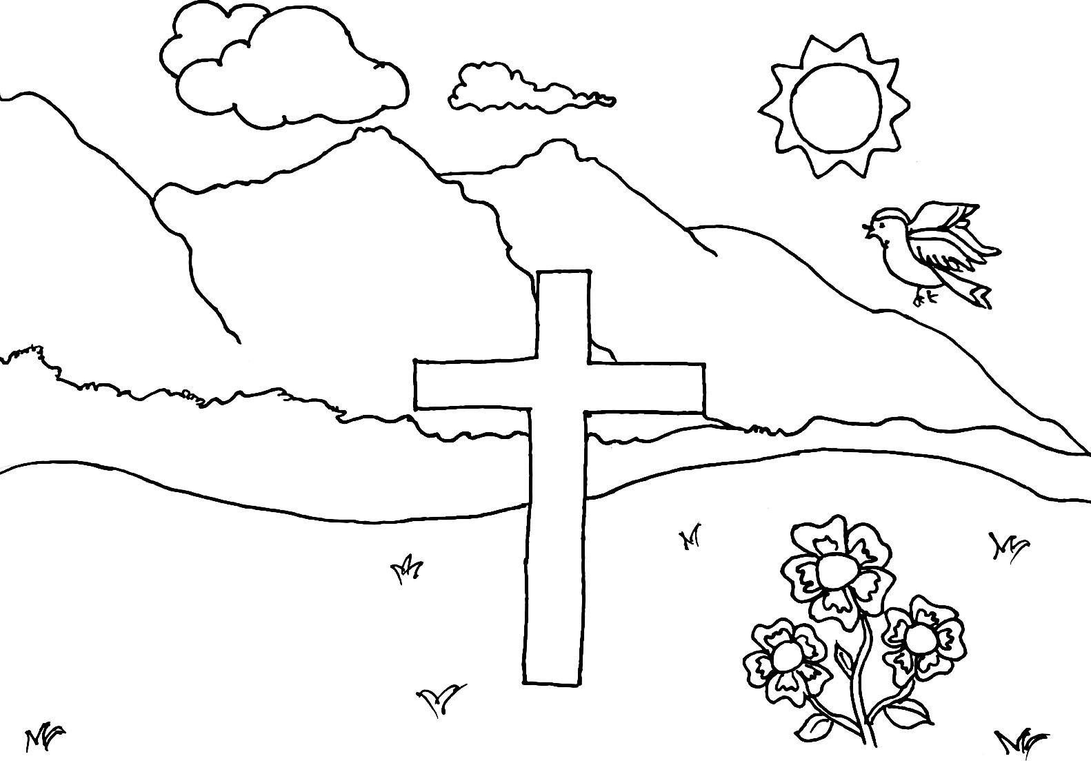
Lesson #309 The Resurrection and the Death P1
MelquisedecLisbet

Slide 4
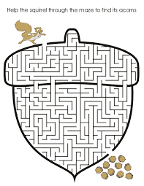
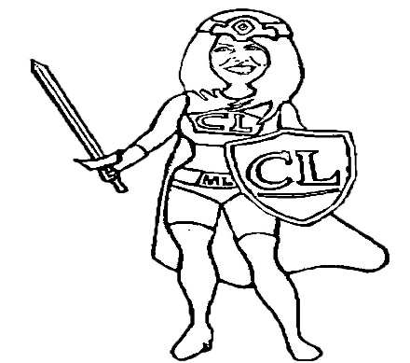
Lesson #309 The Resurrection and the Death P1
Christ Lisbet resurrected you, She is your Help Mate and now helps you conquer the thoughts that want to destroy you, so you can have Eternal Life. She will help you cross the maze.
I took my cross and followed Christ Lisbet, I came out triumphant and reaped well.

