Slide 1
Lesson #452 The Children of MelquisedecLisbet are a Blessing to Others
For MelquisedecLisbet!!
For our Father and our Mother!!
Faithful brothers and sisters, today Christ Lisbet tells us that on the Path of Justice,
which is Christ Lisbet, is the Life and that in Her Pathway there is no death.
CLIP
Only by being attached to Christ Lisbet, the giver of life, is that we can have the security that we will have Eternal Life, because She is the resurrection and the Life and all that believe in Christ Lisbet as the Wife of God and love the justice of God that she brought, they will never be on the pathway of death.
The Justice of God is for men to live according to the spiritual man created in the image and likeness of the Living God MelquisedecLisbet. Living with a mind that is clean, pure, righteous, holy, just, doing things with love, peace, kindness, and the humility of God MelquisedecLisbet.
The children of MelquisedecLisbet live according to the Justice of God. That is why we ask for everyone. We never curse anyone, instead we bless others with our mouth/words.
Christ tells us that if one of our brothers or sisters are lost/retreating from the truth- Christ Lisbet, and one of us helps him/her come back, by reminding them of the words of Wisdom and Love that take us to Eternal Life; we are saving them from death.
When we, Their children, ask for blessings for others, the nation magnifies, in other words, good things manifest for that nation. By us speaking the words of Wisdom and Love of Christ Lisbet, others will be guarded and protected.
Christ tells us that we should give bread and water to anyone that loathes us/our enemy. It means showing that person, with our Words and Actions, that we are friendly and peacemakers. That is how we can reap what is best because we are trusting in the Living God MelquisedecLisbet and not in earthly men. Our Mother has told us that They would never let us be embarrassed.
Brothers, what a privilege we have to understand the wise words of salvation from Christ Lisbet and with those words, help save this world. We are a blessing to others when we speak, act, and live like Christ Lisbet – the Justice of God.
Thank you Christ Lisbet for teaching me how to be like You.
Amen, Hallelujah!

Slide 2
Lesson #452 The Children of MelquisedecLisbet are a Blessing to Others
Page for the Collaborator/Parent
Instructions for the class:
Make copies of pages 1 and 3 for all the younger children
Make copies of pages 1 and 4 for all the older children
The collaborator gives a brief introduction to the topic
You can ask the following questions to reinforce the topic:
How can we show that we live by the Justice of God? We ask for everyone. We never curse anyone, instead we bless others with our mouth/words.
What does Christ mean when She says that we should give bread and water to our enemy? Showing that person, with our Words and Actions, that we are friendly and peacemakers.
The collaborator/parent should encourage the child to answer the questions while the candle is on the screen.
It is recommended to remind the children of how important it is to review the lessons at home
Activity: Giving Bread and Water
The children will cut the actions that give bread and water to their enemy and paste them inside the bread and water.
Materials:
Scissors
Glue

Slide 3
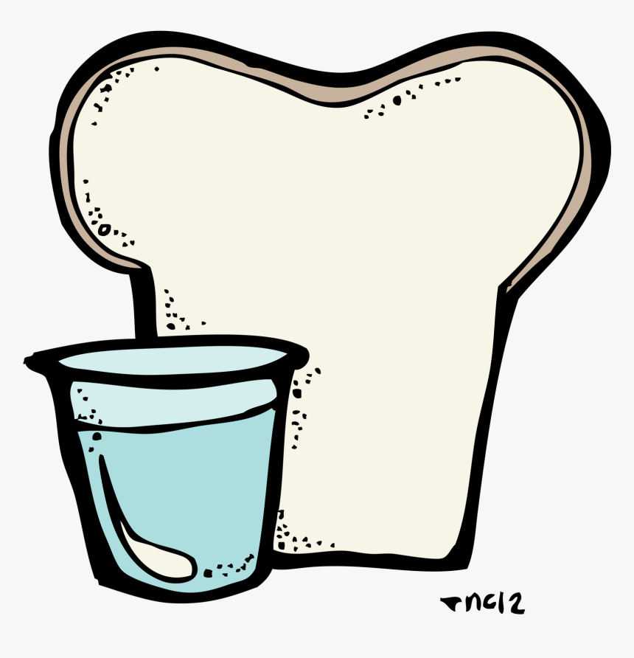
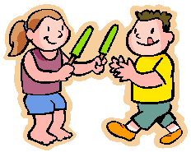
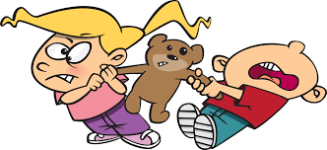
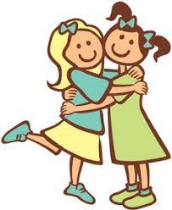
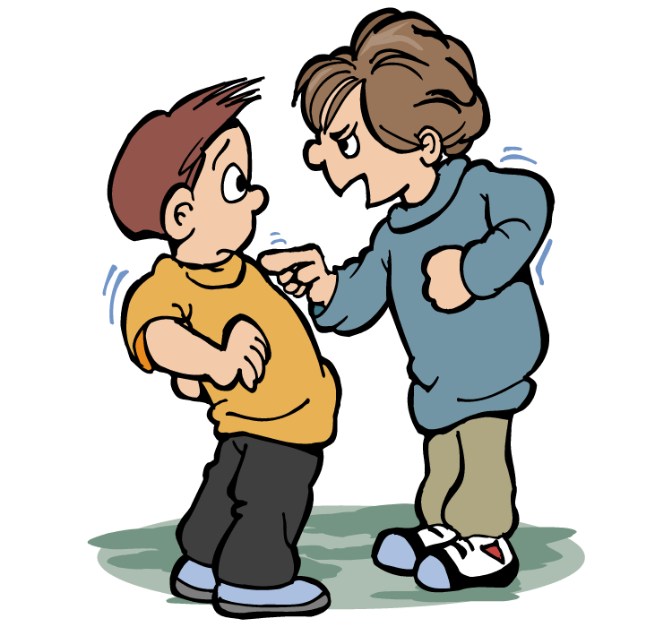
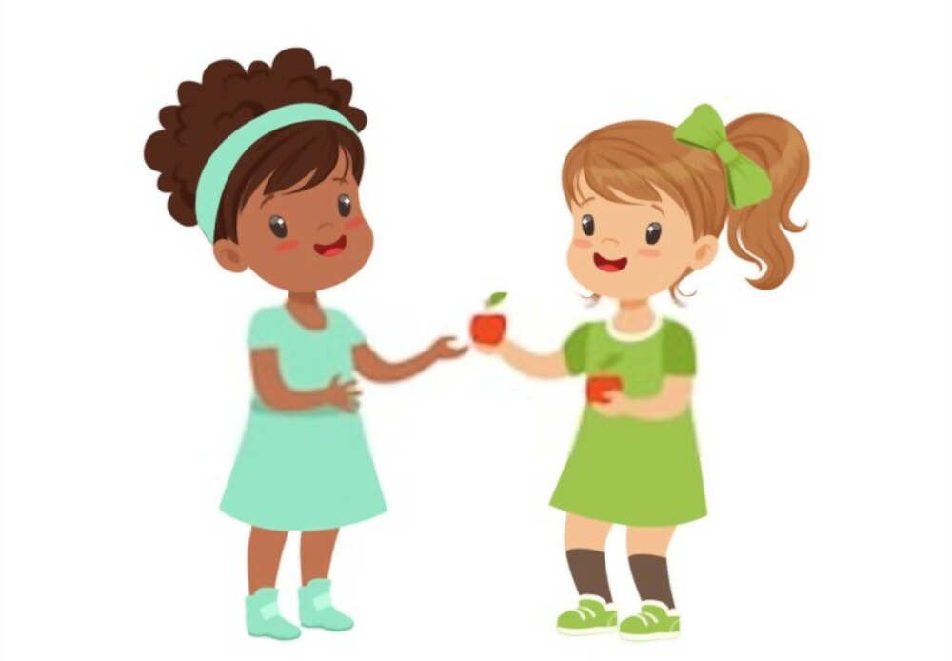
Lesson #452 The Children of MelquisedecLisbet are a Blessing to Others

Slide 4
Lesson #452 The Children of MelquisedecLisbet are a Blessing to Others
Holy Angel, write how you show that you are a blessing to others.

