Slide 1
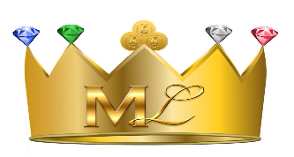
Lesson #289 The Goddess Nut & Christ Lisbet
For MelquisedecLisbet!!
For our Father and our Mother!!
Holy angels, today we Will learn about the Goddess Nut from Egypt that represents
another figure of Christ on Earth. Christ also reminds us of other biblical figures.
The Egyptian story says that the Goddess “Nut” or “Nuit”, was to them the Mother of the gods and the Queen of the heavens. The Egyptians believed that the sky was a woman covered in stars. The Goddess Nut was the personification of The Creative Divinity of the Universe. She was the Mother of all the heavenly bodies that entered through Her mouth and came out as if she had given birth to them, like stars. Some of the titles that they gave Nut were:
Lady of All
The One Who Sustains the Thousands of Souls
The Protectress
The Great One who birthed the gods
The Egyptians organized their gods in family groups, first in pairs, man and woman as representation for the ones that formed the Creation. Nut was a friend to the dead, a Maternal Guardian that helped the souls unite with Her. It is said that Nut made the dead, that approached Her, reborn to protect them. Then those would become stars within Her Body.
Christ Lisbet has clarified that Egypt is a figure of the carnal mind and is figure of where Christ is taken from and resurrected by God the Father. When God speaks of Egypt, Israel, the Garden of Eden, etc. They are not referring to a physical place, instead they are spiritual figures. When They speak about death, it means dying to the carnal mind.
In 2010, in the past dispensation, Christ Lisbet went to her gynecologist (a women’s doctor) for a medical procedure and while the doctor examined her he said that he had “never seen something like this before.” Our Mother asked if there was something wrong? He said he needed to bring in two other doctors to ask their opinion. Our Mother asked him what he saw and he answered that he saw many blue dots, like lights, on the walls of her uterus. Our Mother asked to see it and when She saw the screen she said that “It looked like the night sky full of stars”. The doctors couldn’t explain what they had seen.
How beautiful brothers and sisters, how the signs follow Christ Lisbet. Not even the doctor could explain how our Mother could have lights like stars in Her womb. Christ has always been the same like it says in Hebrews 13:8. That is why we can understand why the Egyptians believed in that the Sky was a Woman covered in stars. That identifies Christ Lisbet, the only one that gives birth to children of the promise and with Her Word she makes us shine as her stars. We are those immortal children that God the Father Melquisedec engendered in God the Mother Christ Lisbet and She gives birth to the spiritual children to create Her descendants, Her strong people.
Genesis 26:4 and Job 38:7. All of this is fulfilled today because Christ is manifested and we are with Her like the stars in Her womb. Christ Lisbet is the Lady of All, Sustains the Thousands of Souls, and the Protectress. Her Wisdom allows us be reborn from Her spiritual womb to be freed from physical death. She is the Queen of Egypt because She reigns over the carnal mind.
Thank you Christ Lisbet for taking me to die to the carnal mind and that way be alive for God and be able to enjoy Your eternity. Amen, Hallelujah!

Slide 2
Lesson #289 The Goddess Nut & Christ Lisbet
Page for the Collaborator/ Parent
Instructions for the class:
Make copies of pages 1 and 3 for the younger children, make copies of pages 1 and 4 for the older children.
The collaborator gives a brief introduction to the lesson and shares the following definition:
Maternal Guardian: A mother that takes care of and helps Her children.
Medical Procedure: A medical exam, operation, or surgery.
You can ask the children the following questions if you do not have access to the video:
Who was Nut for the egyptians? The Mother of the gods and the Queen of the Heavens.
What did the egyptians believe was the Sky? They believed the Sky was a woman covered in stars.
How are Nut and Christ Lisbet alike? Nut means heaven and Christ Lisbet is God’s Heaven. Mother of spiritual children, Her stars. They have seen both of them as Lady of All, The One Who Sustains the Thousands of Souls, and the Protectress. Nut was the Queen of Egypt and Christ Lisbet is the Queen of Egypt because she reign over the carnal mind.
The collaborator should motivate the children to answer the questions while the timer is on the screen.
Activity: Christ Lisbet is True Love
The children will create a scenery of the night’s stars. Just like our Mother saw it.
If the children are too young they can use the cutouts from page 3 to make the scenery.
Cut out the stars and the moon and glue it onto construction paper.
You can cutout the super hero Christ Lisbet and glue her to your scenery.
Materials:
Crayons/ colored pencils
Blue construction paper
Scissors
Glue

Slide 3
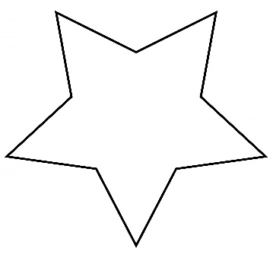
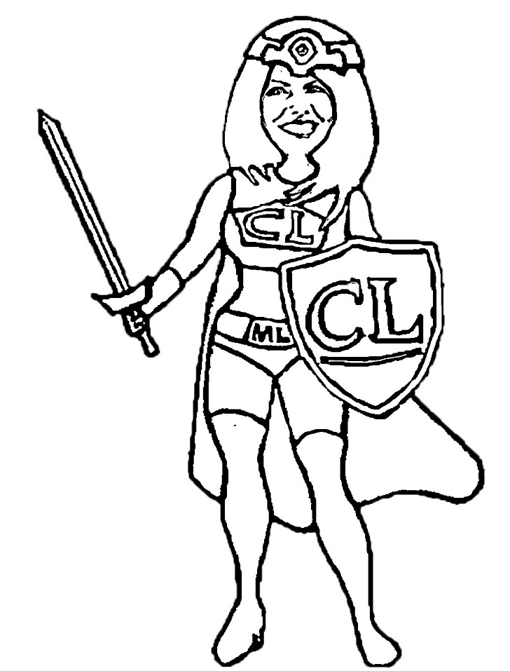
Lesson #289 The Goddess Nut & Christ Lisbet

Slide 4
Lesson #289 The Goddess Nut & Christ Lisbet
Bright stars, complete the word search.

