Slide 1
Lesson #282 Gratitude from the Children of MelquisedecLisbet
For MelquisedecLisbet!!
For our Father and our Mother!!
Beloved brothers and sisters, today we will revisit some of the testimonies from
our sisters that wanted to give thanks, glory, and honor to our Parents
MelquisedecLisbet for how They care for all of Their faithful children.
Testimony from Emilly Silva from Brazil: Clip One
How beautiful it was to hear how grateful our sister is for the care that MelquisedecLisbet had for her during the process of change in her family. She left with her mother to live in a new place and go to a new school, and she missed her father, friends, school, and neighborhood. For a brief moment, she let sadness dominate her. But our Parents are always there to help us.
Emilly asked our Parents MelquisedecLisbet and her petition was answered. In one day our God allowed that they approve her transfer to her old school and now she is very happy again with her parents in her old neighborhood and with her friends. She is very grateful to MelquisedecLisbet and wants everyone to know that They are a faithful God with Their faithful children that live in Their Order.
Testimony from Gabriela Corrigeux from USA: Clip Two
Our sister shares that she was able to conquer over the god of laziness that did not allow her to prepare her testimony that gives thanks to MelquisedecLisbet for everything They have given her. She shared that she had to have a lot of patience while our Parents manifested everything she needed to be able to be homeschooled. She wanted to concentrate more on her studies and on spiritual things and not have to keep seeing how her classmates would hurt others by letting themselves be governed by their carnal minds.
Our sister asked our Parents that in her sixth grade year she would be able to concentrate and that she would do well in school to have better grades. That is exactly what happened.
Beloved brothers and sisters, how great is it to know that God MelquisedecLisbet
grant our petitions in the perfect time.
It pleases our Parents very much when Their children share their testimonies with others because this helps us all to trust each day more and more in our Almighty God MelquisedecLisbet.
Thank you MelquisedecLisbet for your care of us. Amen, Hallelujah!

Slide 2
Lesson #282 Gratitude from the Children of MelquisedecLisbet
Page for the Collaborator
Instructions for the class:
Make copies of pages 1 and 3 for the younger children
Make copies of pages 1 and 4 for the older children
The collaborator gives a breif introduction to the lesson.
Activity: Grateful to MelquisedecLisbet
The children will color the drawing on page 3.
Materials:
Crayons/ colored pencils
Pencils

Slide 3
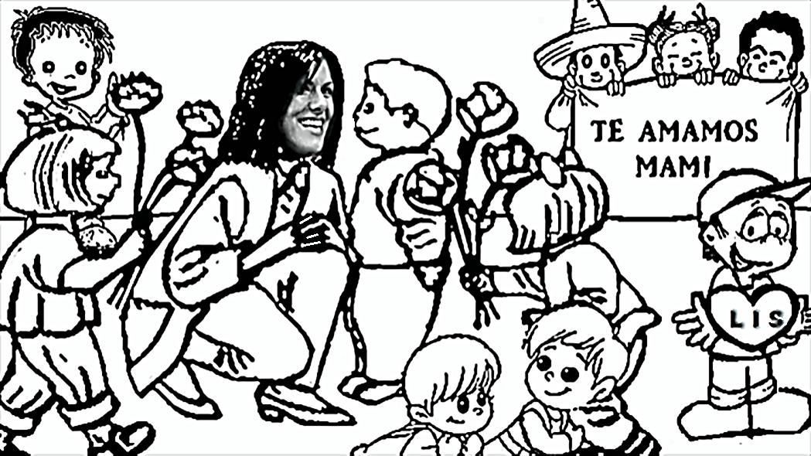
Lesson #282 Gratitude from the Children of MelquisedecLisbet
Color the drawing of the children being grateful to MelquisedecLisbet
We love you
Mother

Slide 4
Lesson #282 Gratitude from the Children of MelquisedecLisbet
Holy angel, write your testimony or a poem to give thanks to MelquisedecLisbet.

