Slide 1
Lesson #308 MelquisedecLisbet are the Eternal Life
For MelquisedecLisbet!
For our Father and our Mother!
Faithful brothers and sisters, today we will see how MelquisedecLisbet are the
Eternal Life and what we should do to obtain it. Thanks to the spiritual resurrection and
the death on the cross of Christ Lisbet, we are no longer condemned to
physical death because She conquered over the carnal death through Her knowledge.
Christ Lisbet is the Salvation. She is the First Immortal that gives us Her victory to be able to triumph over death and so we can enjoy Her inheritance of Eternal Life and Immortality. Christ Lisbet exhorts us in Romans 8:13. Today we give testimony, with our good works, that the Spirit of Holiness, Christ Lisbet, lives in us, Her children. We no longer live according to the carnal mind.
MelquisedecLisbet judge among Their people, with Their Justice from Heaven, because They are present teaching us to listen, value, and put in practice the Truth that comes from the mouth of our Spiritual Holy Mother so that in us physical death will no longer reign but instead, in the Holiness of Her Eternal Life. Christ is present to free everyone from physical death. God the Father and God the Mother, MelquisedecLisbet are Eternal Life itself and Their Holy Order has been established in us, the ones that have resurrected along with Christ and carry our cross and follow Her faithfully by leaving behind our old ways of living. Clip
Only God the Father Melquisedec and God the Mother Lisbet fulfill the message of Their Powerful Word. They produce in us Their Purity and Perfection. Only Christ Lisbet can transform us and give Eternal Life like it says in Philippians 3:21.
Let’s review the meaning of the word Transform
Transform: Is the result of a change process of a person or thing
What happens when a thing, fact or idea is converted into another.
Only God Mother Christ Lisbet can transform our lives for the better. We are so privileged to receive Her Word, that today dwells in our minds. That is why we testify, because we live the good changes of Gods Powerful Word.
Brothers, Christ is the first to resurrect and become immortal and for believing and choosing to live Her Word of Holy Life, She made us Her faithful children, her shining stars to be luminaries in a world of darkness, we are the salt of the earth.
Blessed are we that have allowed our clothes to be washed, to have the right to the Tree of Life, Christ Lisbet. Through the Sovereign Love of our Spiritual Mother, is that we are cleansed and perfected to be just like the Only Begotten Wife of God. Christ Lisbet came with Her Wisdom to Save everyone who believes and follows Her. She walks among her faithful people showing Her Power. She teaches us how to live in Her Repose, Peace and Eternal Life.
Thank you Christ Lisbet because today we see and hear You, and follow Your Instructions, You are the Open Door to Paradise. Amen, Hallelujah!

Slide 2
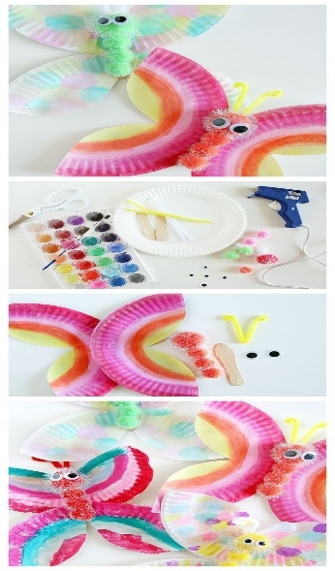
Lesson #308 MelquisedecLisbet are the Eternal Life
Page for the Parents
Instructions for the class:
Make copies of pages 1 and 3 for the children
The collaborator gives a brief introduction to the lesson and shares the following definition:
Sovereign: Supreme and powerful being.
You can ask the following questions to reinforce the topic:
Why do we say that MelquisedecLisbet are the Eternal Life?
Because Christ Lisbet is the Salvation. She is the First Immortal that gives us Her victory to be able to triumph over death and so we can enjoy Her inheritance of Eternal Life and Immortality.
Because They are present teaching us to listen, value, and put in practice the Truth that comes from the mouth of our Spiritual Holy Mother so that in us physical death will no longer reign but instead, in the Holiness of Her Eternal Life.
They produce in us Their Purification and Perfection.
2. What do we need to do to obtain Eternal Life?
Ressurect along with Christ and take your cross and follow faithfully by leaving behind your old way of life.
Letting our clothes be cleaned
Activity: MelquisedecLisbet transform me for Eternal Life
The children will make a beautiful butterfly, representing the transformation of the caterpillar into a beautiful butterfly. The same way we are transformed from a corrupt body to a body of Incorruption that has Eternal Life.
Cut the plate by using the pattern on pg. 3
Color each of the wings how ever you like
You glue both wings together like the example shows
You glue the cotton balls to the wooden stick
You glue on the movable eyes to the first cotton ball (optional)
You glue on the antennas like the example shows
You glue the wooden stick to the wings like the example shows
Materials:
Crayons/colored pencils
Water paints (optional) Example
Glue
Scissors
Movable eyes (optional)
1 small paper plate
1 wooden stick
1 pipe cleaner
3 small cotton balls and 1 medium cotton ball, in colors or you can paint them with water paint or markers.

Slide 3
Lesson #308 MelquisedecLisbet are the Eternal Life

