Slide 1
For MelquisedecLisbet!
For our Father and Mother!
Lesson #335 The Promises of God MelquisedecLisbet
Faithful brothers and sisters, today we will learn the importance of living a holy life, to live as the
children of God that we are to be able to gain all the promises from God MelquisedecLisbet.
Our Parents always fulfill their promises, without margin of error. But it is important to know the Just Will of God so we can respect it in obedience. It is necessary to reject everything that does not please our Creators. That way we Will have the high honor of forever living in Their Holiness and being able to enjoy life in pure Joy, Confidence, Peace, and so that everything goes well for us because MelquisedecLisbet do not lie.
Knowing how to love in Their Spirit and Truth: it does not matter if we are a prophet that understands the mysteries of God, knows God, and talks about Christ Lisbet and Her Faith, if we do not know and understand what it means to love with purity like MelquisedecLisbet do. The will of our Parents is for us to be one with Them, just like They are One in Love.
“Natural love” of human beings is an emotion that is born, grows, and dies. It is bonds of love that die off because they are based on human relations. They can not be predicted because they are always changing and deteriorating. Many times, that love goes from being love to being pain because sometimes it causes scars so deep that they cannot be healed. In conclusion: the Love of humans always ends in hurt.
The love of MelquisedecLisbet is not known by humans, because it is an Action of Love of Two that are One. One does not function without the other. They work together in favor of and in function of all Existence. They do not have favoritism, it is a sublime act. The Faithfulness is not understood by the mind of man, but us, their spiritual children do understand it. We do not get tired, each day, we strive to be even more clean and holy. We continue the race until we reach the Glory of Walking at the same pace as our Creators. We are learning to be faithful and brave in God because spiritual life is clearer in our mind each day. The older brother lets itself be governed and trusts in the Truth of God and experiences the True Love of God.
Being Humble like God: it takes time, and it is a process. Without their Humility we cannot be just. Without their Justice, there is no Holiness and without Their Holiness you cannot be a Child of MelquisedecLisbet. Their promises are only for Their Faithful and True children. By inheriting Their promises, it confirms to us that we are walking the Good Path of God.
Respect and Love Nature: it is important, so that the delights of the Earth come out.
The Garden of Eden in the mind is the Promise of God and is under construction. Everyone that does the Holy Will of God and lets MelquisedecLisbet reign in their mind, can appreciate the beauty of Their creation inside of us and in our environment. We, would not mess up this wonderful work, but instead, we take care of it..
The Patience of God: It is very important, and we should have that active everyday, because it is in Her Peace that we can understand what God wants for us. Then little by little start understanding how to advance. That is how we get to know God, Obey Them and do Their Holy Will in EVERYTHING.
Brothers and sisters, being able to see a mortal person with the eyes of the Justice of God and being able to show them the Love of God by treating them well without caring what they think, say, or do, shows that we are like MelquisedecLisbet.
The Glory of MelquisedecLisbet will extend through Earth and we will walk in Harmony and Happiness. No one will have any scars or hurt in their eyes. Instead, we will all be in absolute Holiness in the Reverent Fear of God. The Obedience of God MelquisedecLisbet gives us Their Full Joy and Eternal Happiness.
We are Holy, Just , Loving, Caring, Powerful, Faithful, and Brave children of MelquisedecLisbet. We will reign without margin of error and we will shine without need for the sun or light because our God created a New Day in us and we are no longer vulnerable, victims or prisoners of hurt.
MelquisedecLisbet, thanks to Your Creatin in me, I live in Holiness
and Obedience to inherit Your promises. Amen Hallelujah!
Holiness

Slide 2
Lesson #335 The Promises of God MelquisedecLisbet
Page for the Parent / Collaborator
Instructions for the class:
Make copies of pages 1 and 3 afor the younger children
Make copies of pages 1 and 4 for the older children
The collaborator can give a brief intro to the lesson and share the following definitions:
Perish: To stop exisiting
Predict: To know soemthing that will happen in the future.
Deteriorate: Turn into a worse state of being, to be damaged.
You can ask the following questions about the lesson:
1.How would you describe the love of MelquisedecLisbet? An Action of Love of Two that are One. One does not function without the other. They work together in favor of and in function of all Existence. They do not have favoritism, it is a sublime act.
2.What do MelquisedecLisbet ask of us? That we always strive to be clean and holy so we can be just like Them. To be Humble, Pacient, and respect nature.
It is recommended to remind the children how important it is to review the classes in their homes.
Activity: Drawing
The children will color the drawing on page 3.
Materials:
Crayons/ colored pencils

Slide 3
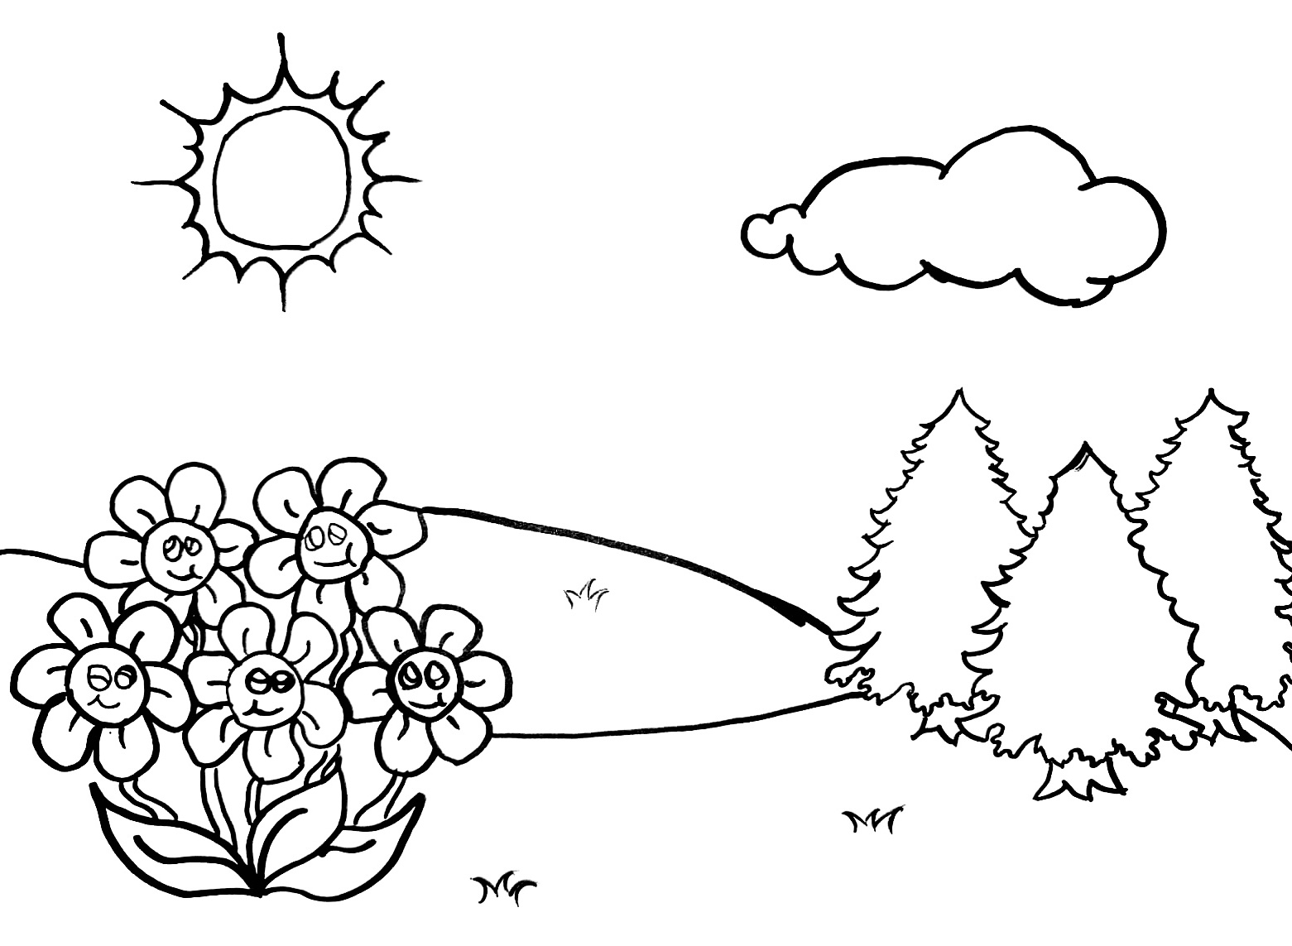
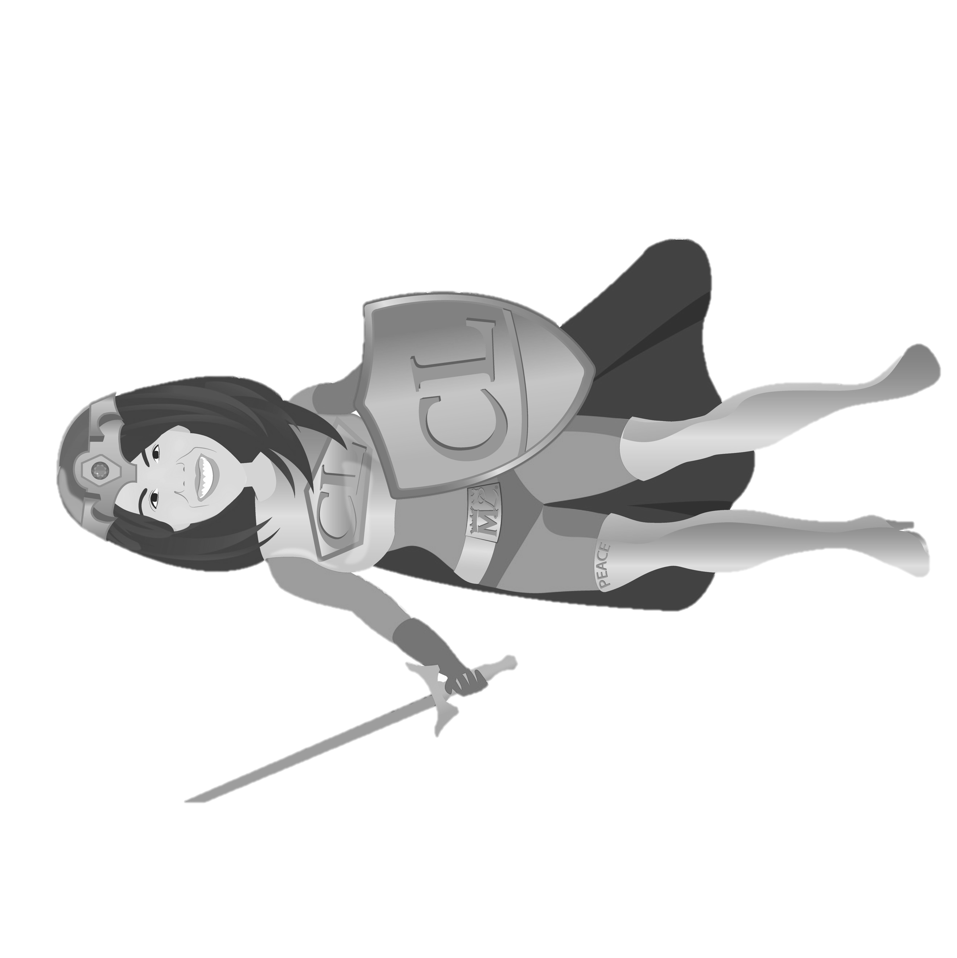
Lesson #335 The Promises of God MelquisedecLisbet

Slide 4
Lesson #335 The Promises of God MelquisedecLisbet
Holy angels, fill in the blanks to complete the following sentences from the lesson:
1. We always need to strive to be __________ and _________ so we can be just like MelquisedecLisbet.
2. Being humble like God takes _________, and it is a ______________.
3. Having patience like God is very important, and we should have that ___________ _________________.
4. The Garden of _________ in the _________ is the _______________ of God and is under construction in us.
5. The ___________ of MelquisedecLisbet is not known by humans, because it is an __________ of Love of Two that are __________.

